Slide 1
Depth Map Upsampling by Self-Guided Residual Interpolation
Y. Konno, M. Tanaka, M. Okutomi
Y. Yanagawa, K. Kinoshita, M. Kawade
Notes:
Good morning everyone. I am Yosuke Konno and graduate student of Tokyo Institute of Technology, Japan.
Thank you chairman for kind introduction.
Hello everyone!
Today I’ll talk about my research on the depth upsampling using the method called “residual interpolation”.
OK, let’s move on to the first topic.
First of all, I’d like to give you a brief introduction of the background and motivation of this work.
(ENTER)

Slide 2
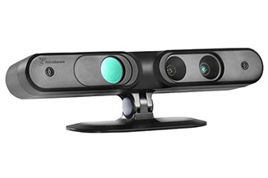
Background
Depth sensors suffer from the limitation on its resolution in the spatial direction.
The improvement of the resolution is required
Notes:
As you know, depth map are widely used in various field including computer vision and robotics.
However, it is said that the resolution of depth maps taken by various depth sensors such as ToF cameras or structured light sensors is quite lower than common color image sensors.
the limitation of the resolution in the spatial domain prevent it from various applications.
So there have been a lot of works to enhance the resolution.
(ENTER)

Slide 3
Previous works
Single depth map upsampling
Intensity-guided upsampling
Upsampling
Upsampling
Notes:
Those works can be divided roughly into two categories.
The one is the single depth map upsampling, which can upsample from only a single depth map.
The other is the intensity-guided upsampling, which uses a high-resolution intensity image as a depth clue.
This kind of method can be said to be common approach because the upsampling of depth map is known to be highly ill-posed problem.
At the first glance, the intensity-guided method is better than single depth map upsampling in terms of the accuracy.
It is true in a large number of the case.
But, intensity-guided method also has several drawbacks compared to the single depth map upsampling method.
(ENTER)

Slide 4
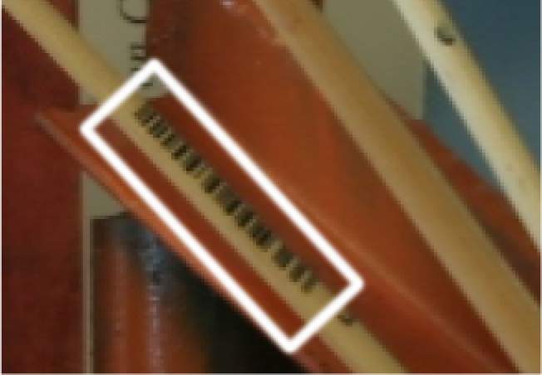
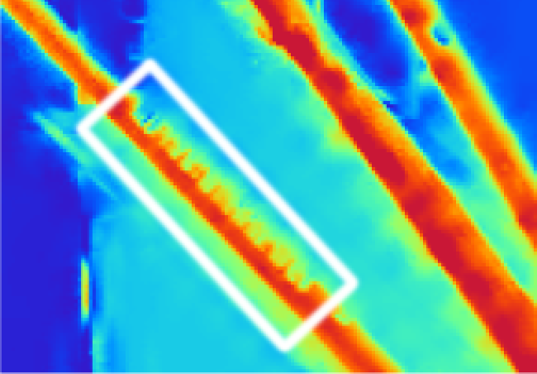
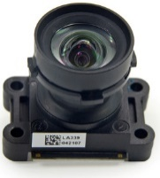
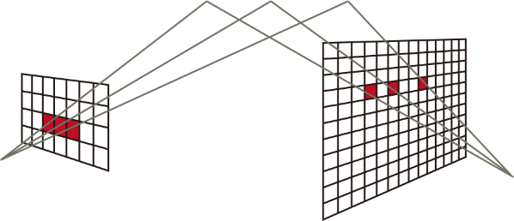
Various drawbacks of intensity-guided method
Texture transferring
Additional camera
Need to take an alignment
take an alignment between depth map and color image
Notes:
For example …
The one is the texture transferring.
Intensity-guided methods assume that strong correlation exists between the depth map and the intensity image.
However, this assumption is not always true.
Severe artifacts appear in regions where the assumptions fail like this figure.
The texture of the barcode is printed on the structure of the paint brush in the output depth map.
The second is the additional camera.
Needless to say, if you want to use another image, the additional sensor is needed.
This causes the rise of production cost, and it prevent from miniaturization.
The next is the need to take an alignment.
Alignment between the depth map and the high-resolution intensity image is an very challenging problem.
And if this process didn’t work well, the pixel mismatches are occurred everywhere and they causes fatal error on the output results.
In the first place, there is the case that no additional information is available.
For these reasons, there is nothing better than to be able to upsample sufficiently from only a single depth map.

Slide 5
Proposed frame work
Single depth map upsampling
Intensity-guided upsampling
Proposed upsampling
Notes:
Following this, we proposed 3rd type of upsampling method.
In this frame work, we generate guide image from input depth map itself.
It is expected that we can make use of intensity-guided method while avoiding these drawbaks.
(ENTER)

Slide 6
Proposed method
Notes:
Let’s move on to talking about details of the proposed method.
(ENTER)

Slide 7
Processing pipeline
Upsampling routine
*1 L. Wang et al. “Fast Image Upsampling via the Displacement Field,” TIP 2014
*2 K. He et al. “Guided image filtering,” TPAMI 2013
Notes:
This is the entire framework of the proposed method.
The guide generation in the schematic diagram is correspond to this box(指しながら)
And the upsampling part is correspond to this part surrounded by pink frame.
To begin with, I talk about the guide generation process.
We call the output of this process as Self-guide.
This process is just some kind of a single upsampling method.
Various methods will do in this process.
In the paper, we use the upsampling method via the displacement field proposed by Wang et al.
Anyway, let’s move on to the talk about upsampling routine.
(ENTER)

Slide 8
Upsampling routine
The main upsampling routine consists of two steps
Tentative estimation of the HR depth
Refinement by residual interpolation
Notes:
This routine consists of two steps.
The first one is the tentative estimation of the high-resolution depth map.
The second one is the refinement of this tentative estimate by residual interpolation.

Slide 9
Tentative estimation via self-guide
Self-guide
The tentative estimate is given by the guided upsampling*
*K. He et al. “Guided image filtering,” TPAMI 2013
Notes:
The tentative estimation is given by the guided upsampling.
This method assumes that the tentative estimate can be represented by the local linear transformation of the self-guide.
The linear coefficient is calculated by optimizing this cost function.

Slide 10
Upsampling routine
The main upsampling routine consists of two steps
Tentative estimation of the HR depth
Refinement by residual interpolation
Notes:
After the tentative estimation, residual interpolation follows.

Slide 11
Residual interpolation
Notes:
In this section, I’d like to give you a brief explanation about residual interpolation.
This method is originally proposed as the method of color image demosaicking.
Proposed frame work is following the success of residual interpolation in that field.

Slide 12
Processing pipeline
Interpolate in the residual domain
Notes:
This is the processing pipeline of the residual interpolation.
This method takes two inputs. The one is the low-resolution depth map. The other is the tentative estimation given by some kind of upsampling method.
First of all, we’d like to take the difference between them to obtain the residual map.
But, in this frame work, we deal with the input low-resolution depth map as the high resolution sparse depth map which has the same size as the tentative estimation, as shown in the figure.
So, in the input depth map, there are a lot of pixels which have no value.
Thus we have to mask out the value on the corresponding pixels in the tentative estimate.
That’s why we take the mask here.
Next, we perform some kind of interpolation to the residual map.
Any sophisticated interpolation algorithm can be include here.
But, we use bicubic interpolation in the paper for the easiness to understand this frame work.
Finally we can obtain the high-resolution output by adding the tentative estimate and the dense residual map.
This is the whole pipeline of the residual interpolation.
Next slide, I’d like to give you some idea about the meaning to take the difference.

Slide 13
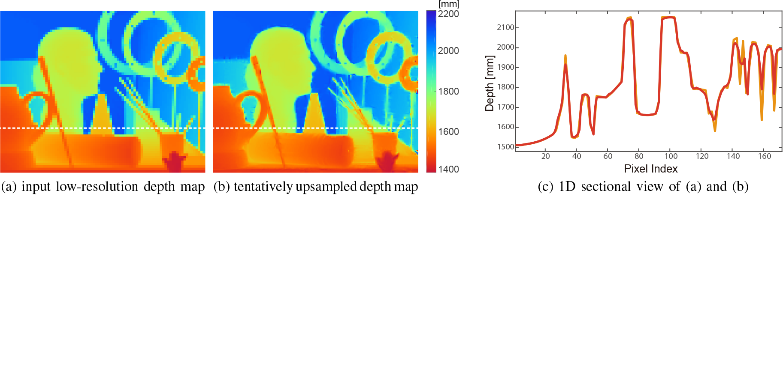
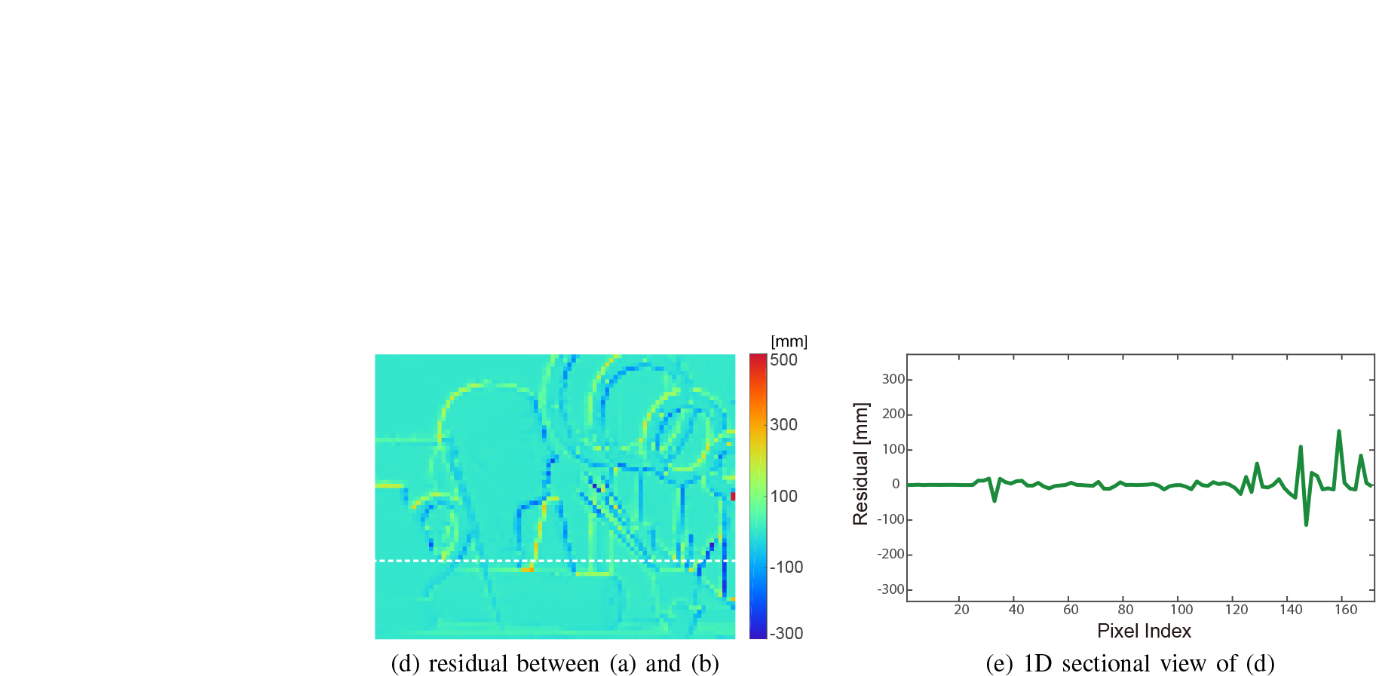
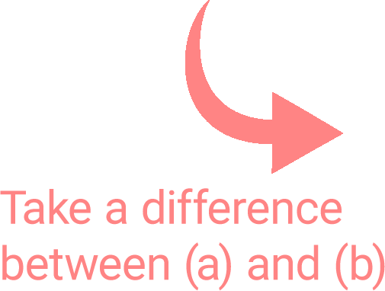
Motivation
Notes:
This is the low resolution depth map.
And this red line is the slice plot of the depth value on the dashed line.
(ENTER)
And this is the tentative estimate of the high resolution depth map.
And corresponding slice plot is this orange line.
(ENTER)
Next, we can obtain the residual map by subtracting the tentative estimate from the input depth map.
You can see that the radical fluctuation of the depth value is extremely suppressed in the residual domain.
(ENTER)
This is the comparison on the gradient energy of both maps.
Residual map has quite low gradient energy.
In general, the interpolation accuracy depends heavily on the input image smoothness.
This is a common property for any kind of interpolation algorithms.
In other words, the low gradient energy of the input image makes interpolation easy.
That observation implies that one can improve the interpolation performance further if the input image could be transformed into the domain with the lower gradient energy.
Residual interpolation has been proposed based on this idea.
Let’s move on the next topic.

Slide 14
Experimental results
Notes:
In this section,we demonstrated quantitative and qualitative evaluations of
the proposed depth upsampling method.

Slide 15
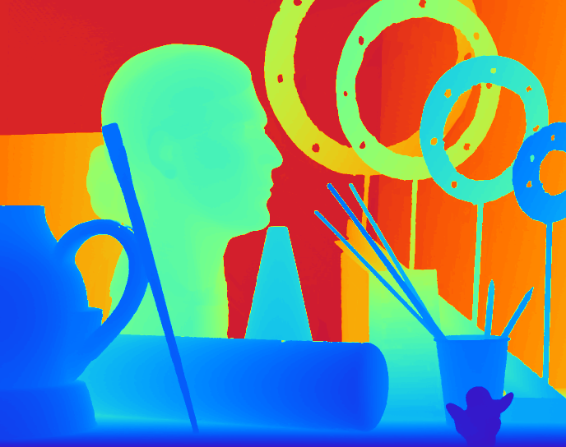
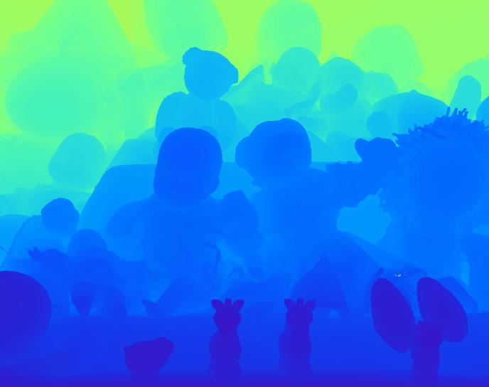
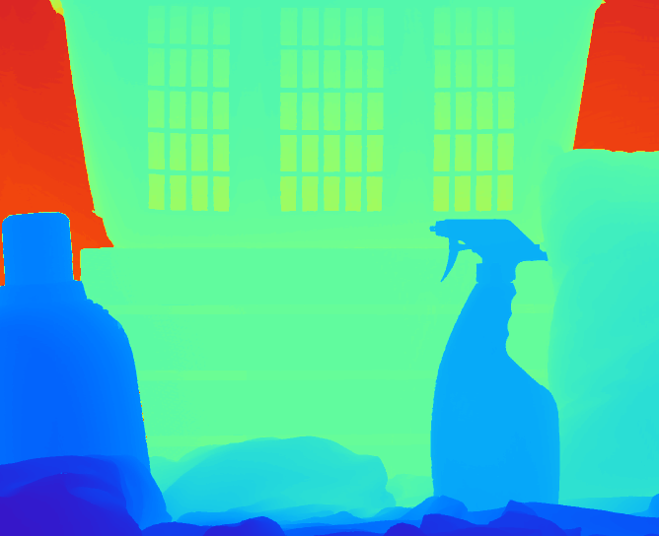
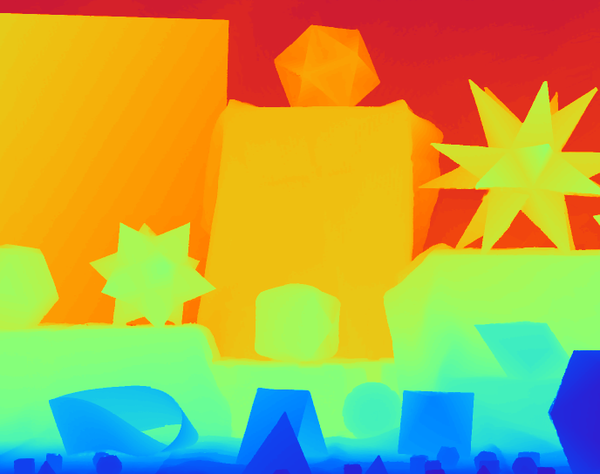
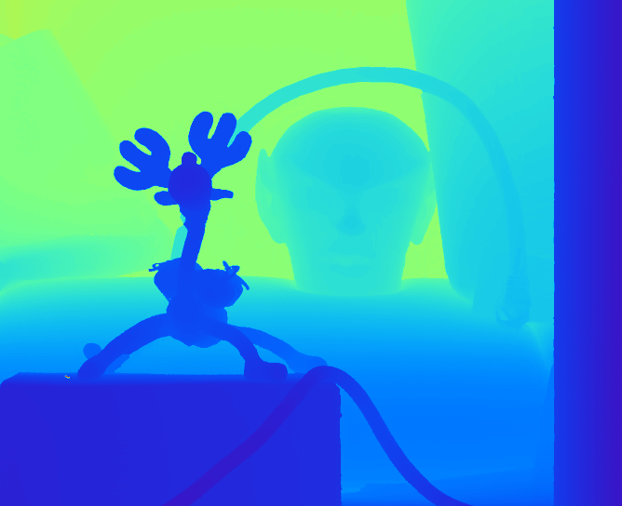
Quantitative evaluation
Upsampling test on Middlebury dataset 2005
Notes:
We first examined the qualitative results and numerical performance compared to state-of-the-art methods with the Middlebury 2005 dataset.
We evaluated the low-resolution depth maps with three downsampling factors (2× 4× 8) generated by downsampling after applying a Gaussian filter.
(ENTER)

Slide 16
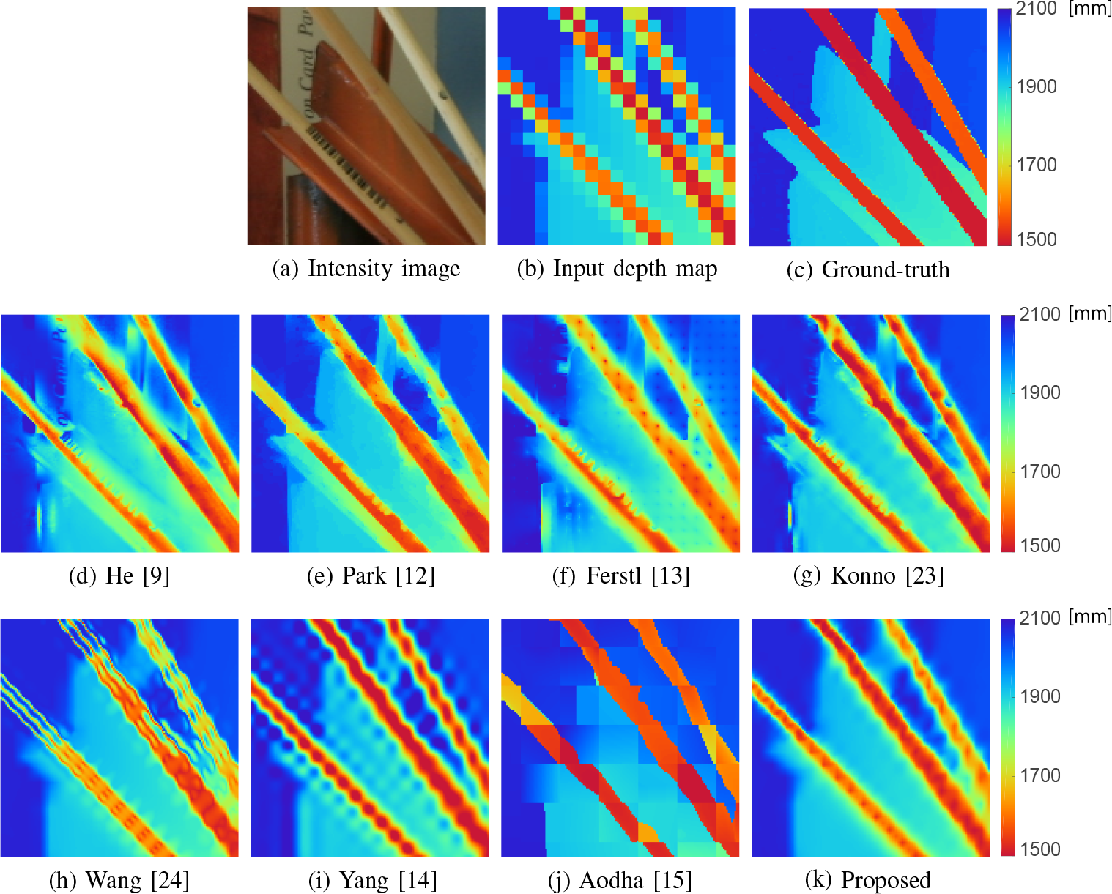
Qualitative results
Intensity-guided method
Single depth map
upsampling
Middlebury upsampling test of ×8 in each direction
Notes:
This is the visual comparison of the 8-times upsampling evaluation.
The middle row is the result of intensity-guided method, and the bottom is single depth upsampling.
Among results of the intensity guide approach, you can find edge-bleeding artifacts by texture transferring, especially in regions of stain and bar codes on paint brushes.
In contrast, no texture transfer artifact appears in the results of the single depth map upsampling algorithm.
The result of the proposed method appears to be the most natural among the results of the single depth map upsampling method.
(ENTER)

Slide 17
Numerical comparison | 2x
Intensity-guided method
Single depth map upsampling
RMSE
SSIM
Notes:
Here is the numerical results of these experiments in terms of the root mean square error (RMSE) and structural similarity (SSIM).
These values are the average of six-scene as I showed earlier.
The method listed left-side are the intensity-guided method. on the right-side is the single depth map upsampling.
The lower RMSE show better results and the higher SSIM value a better results.
in 4 and 8-times upsampling, the proposed method outperforms state-of-the-art methods including the intensity guided approach.
About SSIM, the proposed method invariably shows the best performance for all scenes.
Those comparisons demonstrate that
the proposed method is extremely effective for the case of higher upsampling factor.

Slide 18
Numerical comparison | 4x
Intensity-guided method
Single depth map upsampling
RMSE
SSIM
Notes:
in 4 and 8-times upsampling, the proposed method outperforms state-of-the-art methods including the intensity guided approach.
About SSIM, the proposed method invariably shows the best performance for all scenes.
Those comparisons demonstrate that
the proposed method is extremely effective for the case of higher upsampling factor.

Slide 19
Numerical comparison | 8x
Intensity-guided method
Single depth map upsampling
RMSE
SSIM
Notes:
in 4 and 8-times upsampling, the proposed method outperforms state-of-the-art methods including the intensity guided approach.
About SSIM, the proposed method invariably shows the best performance for all scenes.
Those comparisons demonstrate that
the proposed method is extremely effective for the case of higher upsampling factor.

Slide 20
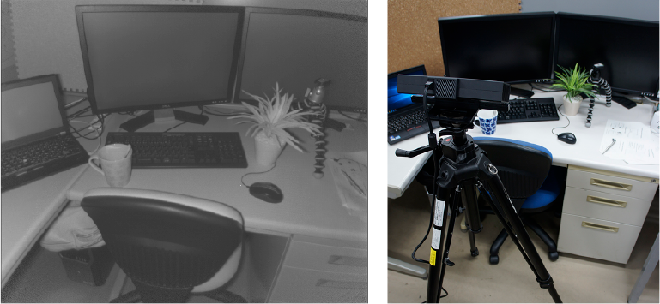
Real data experiments
We performed on the real depth data taken by Kinect v2
IR intensity image
Experimental setup
(a) Input depth
(b) Ground-truth
(c) Aodha
(d) Yang
(e) Wang
(f) Proposed
Notes:
This is the real data test using a depth map taken by the ToF camera.
For depth acquisition, we used Kinect v2.
(We use the depth map for ground-truth and produce an input low-resolution depth map by downsampling the ground-truth.)
This comparison demonstrates that the proposed method can upsample the
depth map of real scene effectively, although Aodha’s and Yang’s methods yield severe artifacts.
Now, let me summarize the main points of today’s presentation.
(ENTER)

Slide 21
Conclusion
One can further improve the interpolation accuracy by performing in the residual domain
residual domain is defined as the difference between tentative estimate and input depth
the tentative estimate is generated from only the input depth map
Notes:
We have proposed a simple and effective single depth map upsampling method based on self-guided residual interpolation.
The key to the proposed method is interpolation of the residual domain, where the residual is defined as the difference between the tentative estimate and the input low-resolution depth map.
In the proposed algorithm, we also generate the tentative estimate, but from only the input low-resolution depth map.
Therefore, the proposed algorithm can upsample using the single low-resolution depth map.
Experimentally obtained results demonstrate that the proposed method outperforms state-of-the-art methods, even including intensity-guided methods in terms of both quantitative and qualitative evaluations.
This is the end of my presentation.
Thank you for your kind attention.

