Slide 1

Robust, Precise, and Calibration-Free Shape Acquisition with an Off-the-Shelf Camera and Projector
Chunyu Li, Akihiko Torii, and Masatoshi Okutomi
Tokyo Institute of Technology

Slide 2
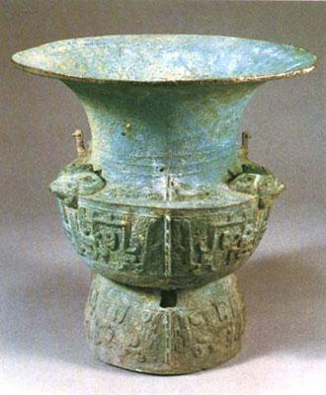
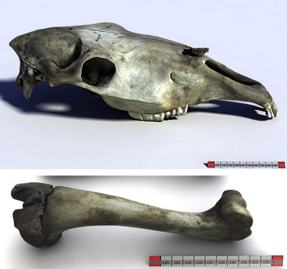
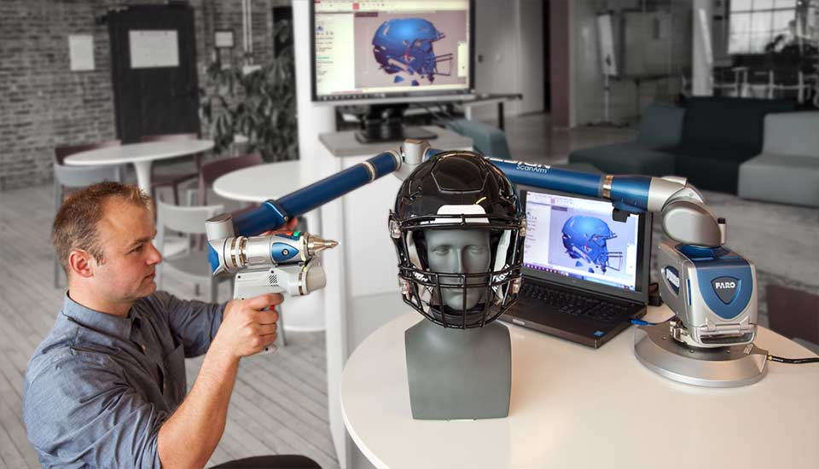
Introduction
Acquiring 3D shapes of real-world objects has attracted significant attention, e.g.
cultural relics:
animal skeletons:
Shortcoming: Expensive sensors, requiring professional skills
Faro 3d:
Image source: english.cntv.cn; Virtual skeletons: using a structured light scanner to create a 3D faunal comparative collection; www.faro.com/ja-jp/

Slide 3
3D reconstruction from images
Structure from Motion (SfM)
  Camera poses + sparse 3D point cloud
Multi-View Stereo (MVS)
  Dense 3D point cloud (+ surface model)
Softwares available, e.g. VisualSFM, COLMAP, MVE, …
Pros: Use images (cameras) only
Cons: Requires objects to be well textured

Slide 4
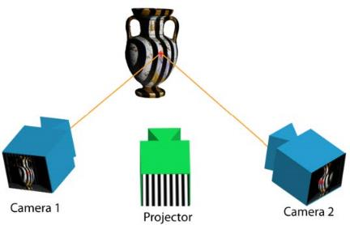
Structured light system
3DUNDERWORLD-SLS [Gu ‘14]
Project a Structured-light pattern sequence
Pros: Precise, not requiring texture.
Cons:
  Require camera calibration (intrinsic and extrinsic parameters).
  Require to merge 3D point clouds in order to obtain the entire shape

Slide 5
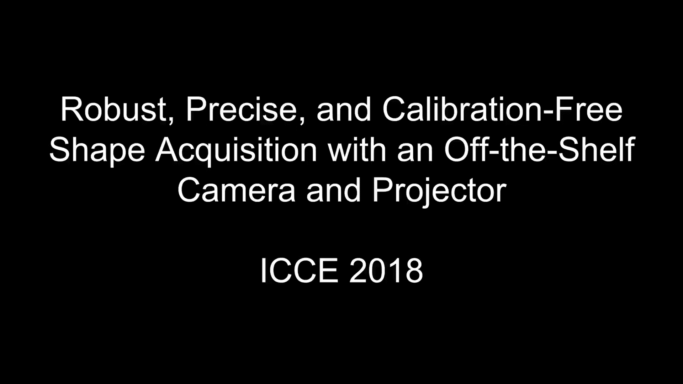

Proposed method
We combine SfM and structured-light technique.
      Precise, not requiring texture and calibration-free!

Slide 6
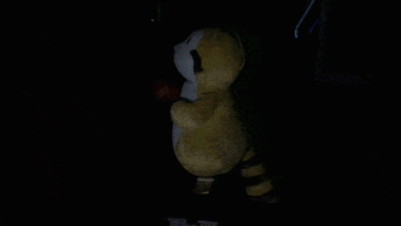
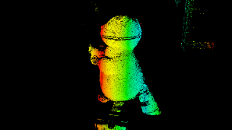
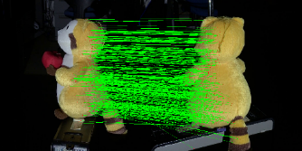
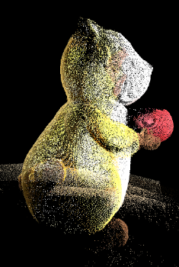
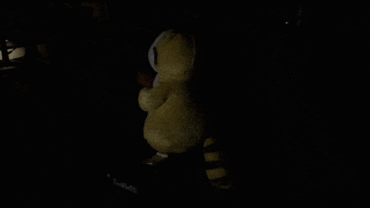
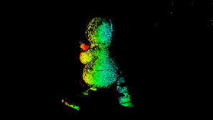
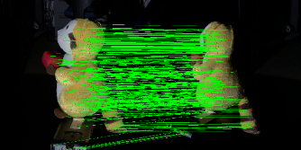
Overview of proposed method
2. Assigning gray codes to image pixels
3. Matching image pixels
4. 3D reconstruction and loop closure
1. Data Acquisition
Camera viewpoint 01
Camera viewpoint 01
Camera viewpoint 01 and 02
Point cloud
Camera viewpoint 02
Camera viewpoint 02
Camera viewpoint 01 and 03
・・・
・・・
・・・

Slide 7
1. Data Acquisition

Slide 8
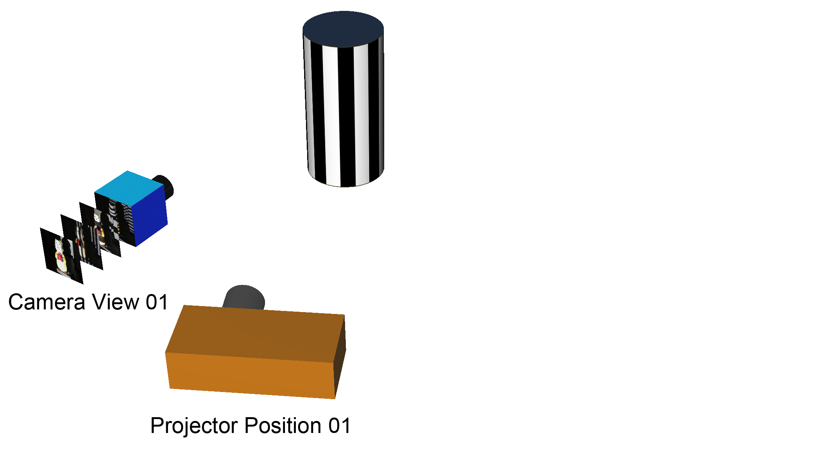
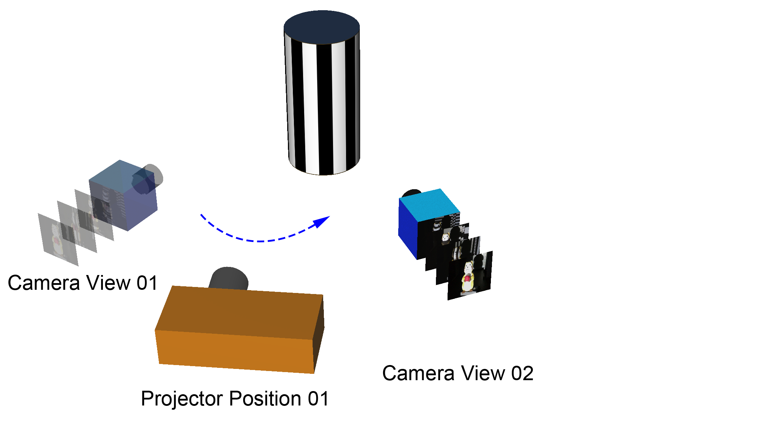
Step1: Acquiring from multiple views
Schematic of the proposed system

Slide 9
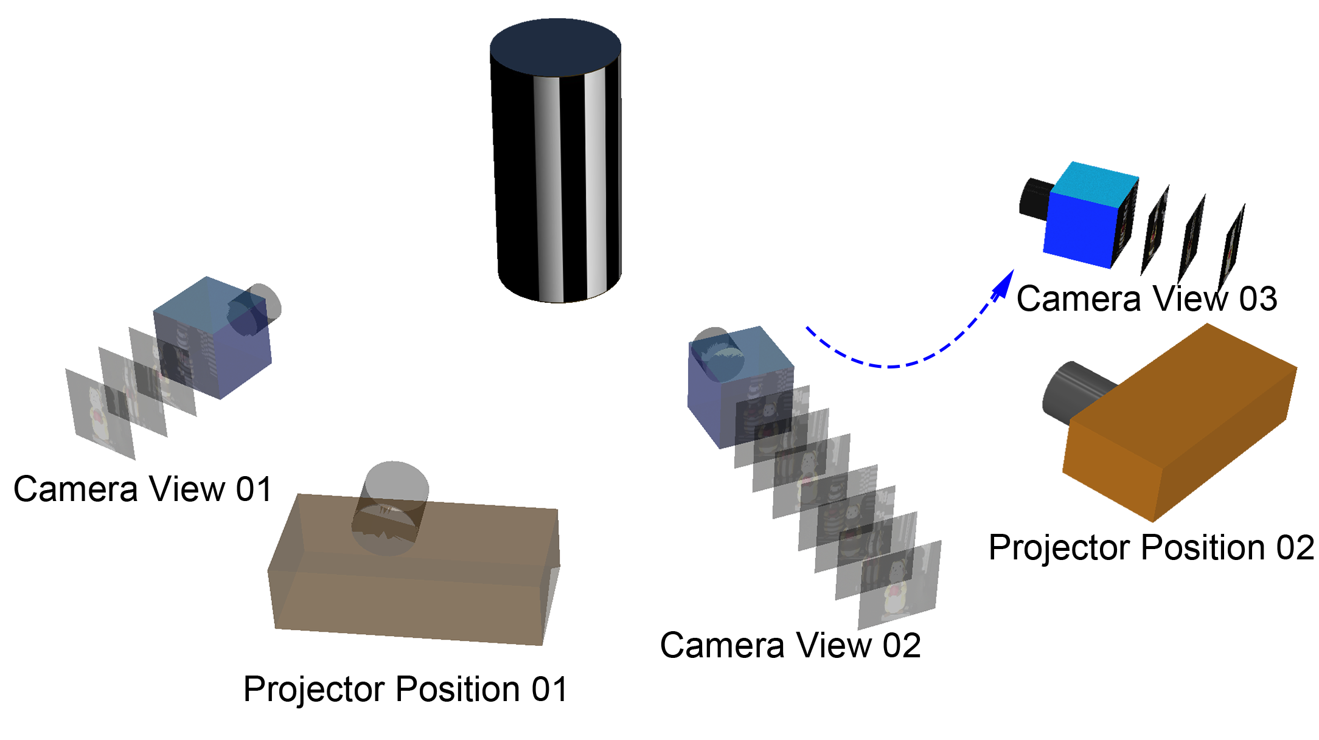
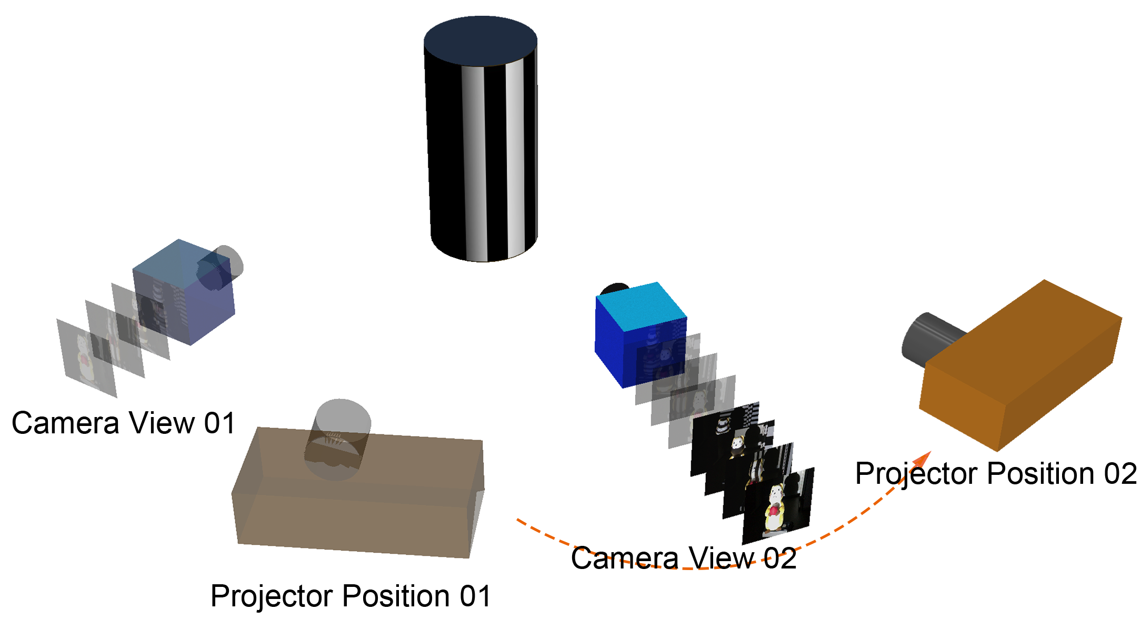
Step2: Moving the projector
Schematic of the proposed system

Slide 10
2. Assigning gray codes to image pixels

Slide 11
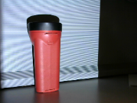
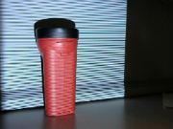
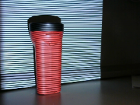
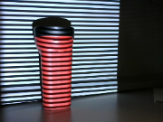
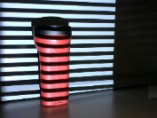
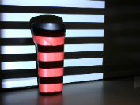
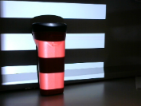
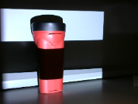
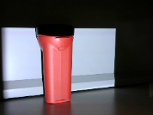
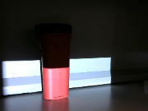
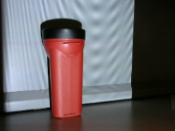
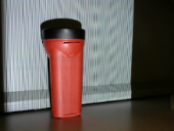
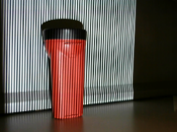
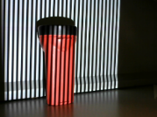
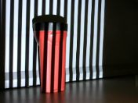
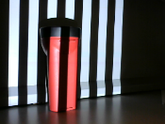
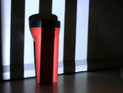
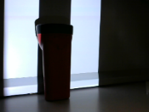
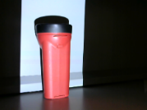
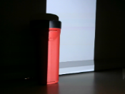
Assigning gray codes to image pixels
The decode algorithm is same as [Gu ‘14]
0
0
1
1
0
1
0
0
1
0
Horizontal:
0100101100(456)
1
0
0
1
1
0
1
0
1
0
Vertical:
0101011001(401)
Decimal number 456401

Slide 12
3. Matching image pixels

Slide 13
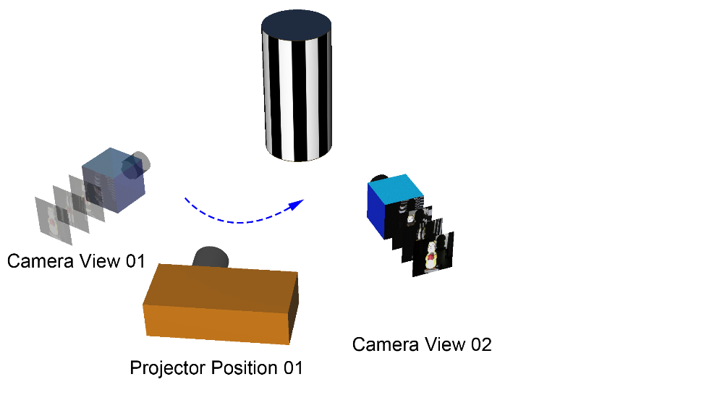
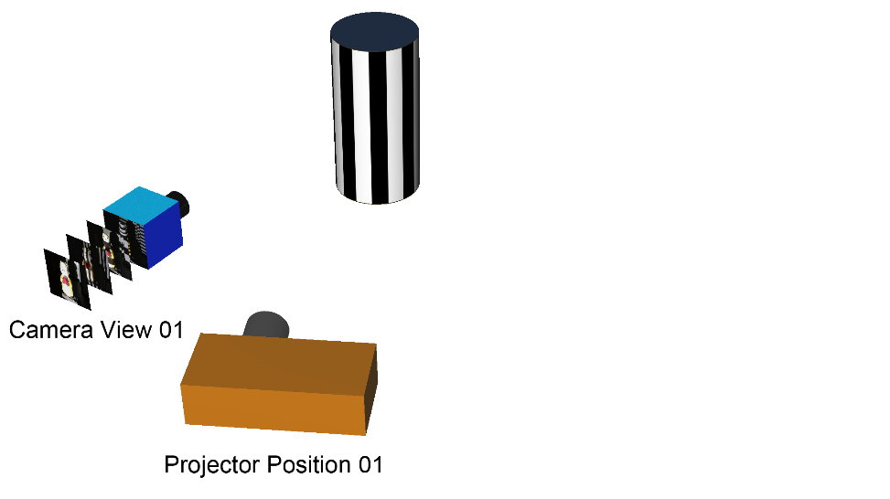
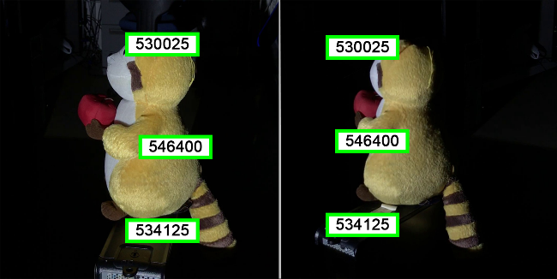
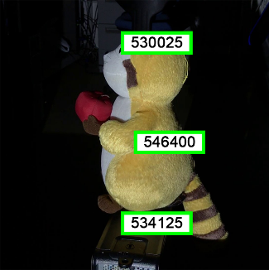
At common projector position
  Connect the pixels in all camera viewpoints which have the same code.

Slide 14
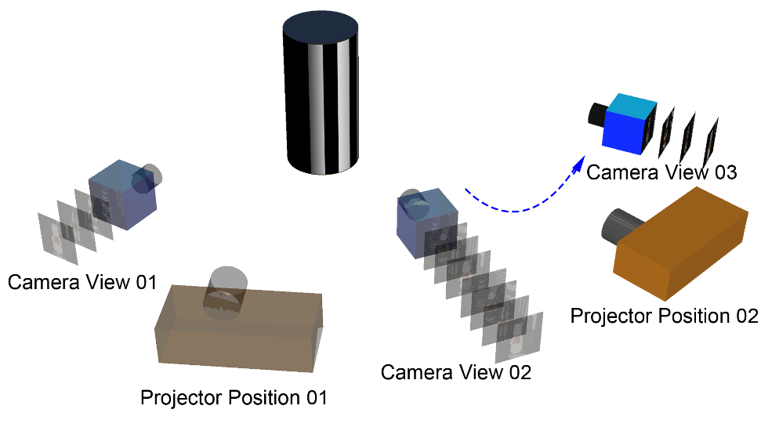
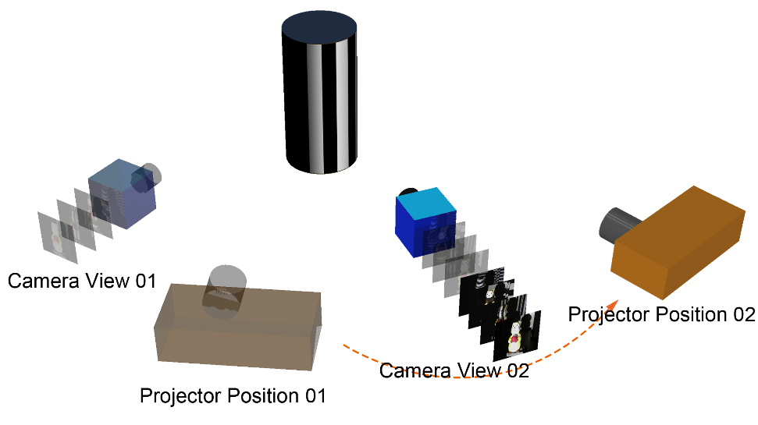
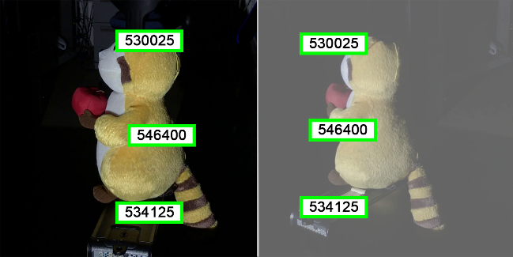
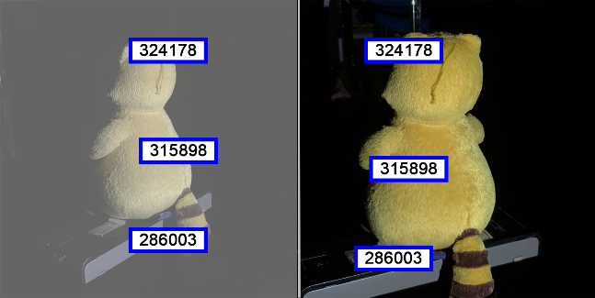
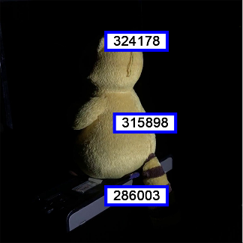
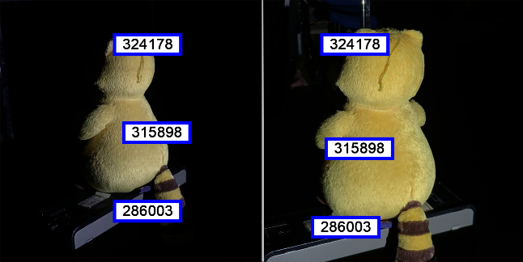
At different projector position
Link the codes located at the same pixel in fixed viewpoint (like the camera viewpoint 02).

Slide 15
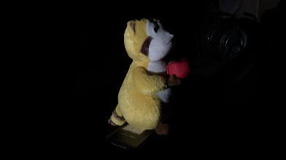
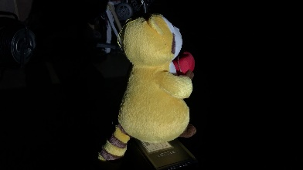
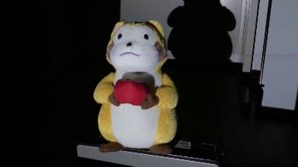
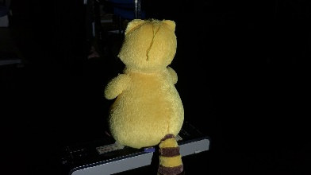



Feature tracks
Then we can obtain the correspondence of all of the images token around the object.
Camera view 05
Camera view 04
Camera view 06
Camera view 03
Camera view 07
Camera view 02
Camera view 01

Slide 16
4. 3D reconstruction and loop closure

Slide 17

3D reconstruction
SfM using feature tracks computed by gray-code matching
  Estimate the camera poses (camera parameters).
  Compute 3D coordinates by performing triangulation and bundle adjustment.
  Output:
Cameras
3D points

Slide 18
Loop closure
Loop closure
  Extract the correspondences between the first and last viewpoints. (Using Iterative Closest Point (ICP) algorithm).
  Employ bundle adjustment again with the new correspondences to close the loop.
correspondences
The last viewpoint
The last viewpoint
The last viewpoint
The first viewpoint
The first viewpoint
The first viewpoint

Slide 19
Experiments

Slide 20

Experiments
Setup
  iPhone7 (video resolution: 1920 * 1080)
  ASUS P3B data projector (resolution: 1024 * 768)
Setup

Slide 21




Results: Gundam Model
Object
Proposed Method
SfM-MVS:
288 input images
Resolution: 1920 * 1080
VisualSFM, CMVS
Google Tango (Tof camera):
Lenovo Phab 2 Pro Smartphone

Slide 22




Results: Plastic bucket
Object
Proposed Method:
SfM-MVS:
532 input images
Resolution: 1920 * 1080
VisualSFM, CMVS
Google Tango (Tof camera):
Lenovo Phab 2 Pro Smartphone

Slide 23
Conclusions
Proposed a stable and high-accuracy entire shape measurement system based on structured-light and SfM technique.
Require no special devices and just use a standard camera and projector
The performance has been confirmed by several experiments.

Slide 24
Thanks for your attention.

