Slide 1
TDM: Temporally-Consistent Diffusion Model for All-in-One Real-World Video Restoration
Yizhou Li, Zihua Liu, Yusuke Monno, and Masatoshi Okutomi
Institute of Science Tokyo
MMM2025

Slide 2
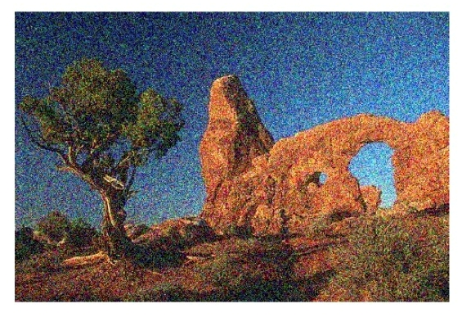
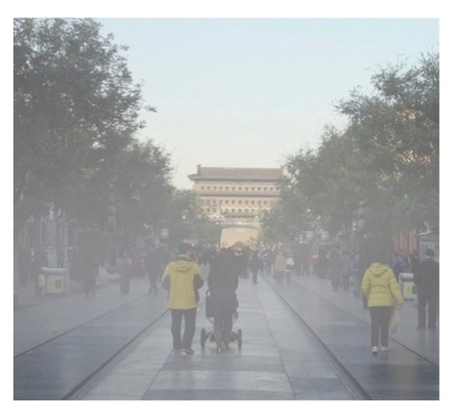
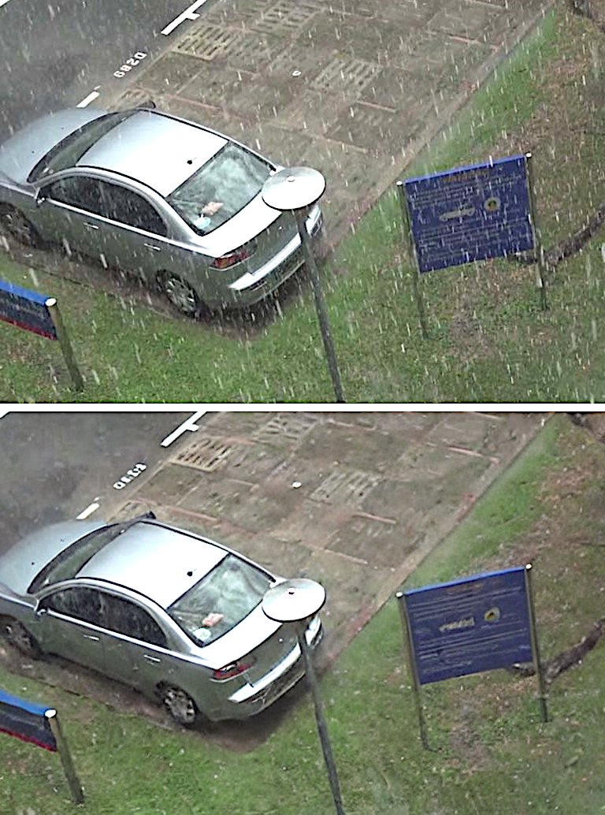
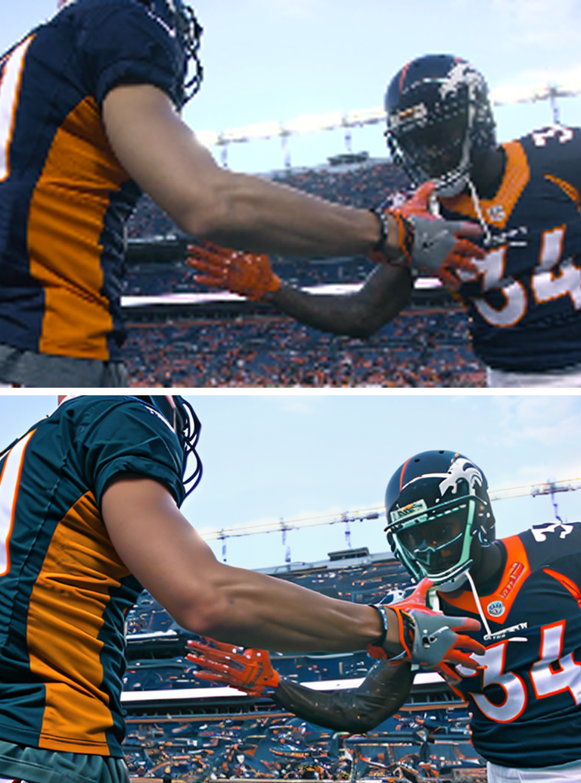
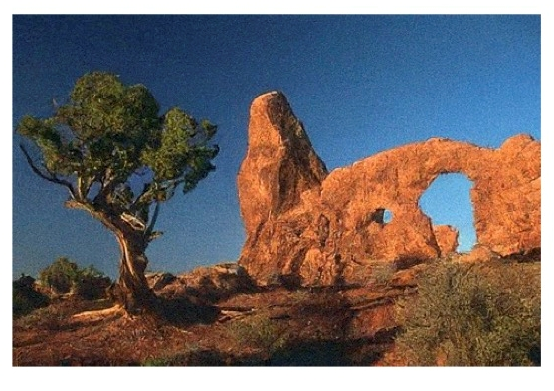
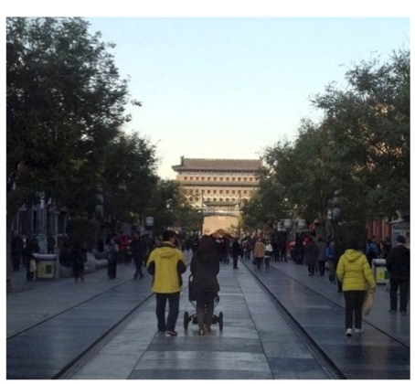
Image Restoration
Denoising
Dehazing
Deraining
Super Resolution

Slide 3
Task-Specific Restoration
Network
Network
Network
Network
Denoising
Dehazing
Deraining
Super Resolution

Slide 4
All-in-One Restoration
A Single Network
Denoising
Dehazing
Deraining
Super Resolution

Slide 5


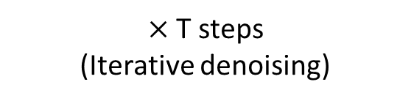
Stable Diffusion on Image Generation
$×$ T steps
(Iterative denoising)
“A woman chasing a dog on a beach”
Condition (Text)
…
…
Sampled noise
Stable Diffusion
(Pre-rained on
degradation-free images)
Generated image
(Degradation-free)

Slide 6

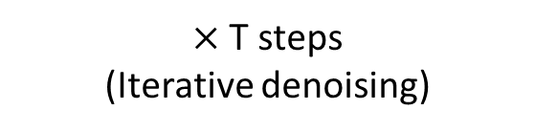
Stable Diffusion on Image Restoration
$×$ T steps
(Iterative denoising)
Degraded Image
…
…
Forward Process
Noisy image
Not a pure random noise,
But derived from degraded Image
Stable Diffusion
(Pre-trained on degradation-free images)
Restored Image
Sampled noise

Slide 7
Stable Diffusion on Image Restoration
$×$ T steps
(Iterative denoising)
Degraded Image
…
…
Forward Process
Noisy image
Not a pure random noise,
But derived from degraded Image
Stable Diffusion
Restored Image
Sampled noise
High generalization ability to real-world images

Slide 8
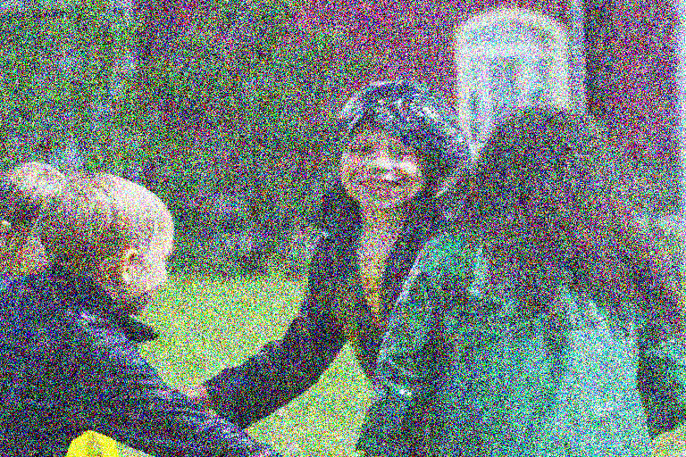
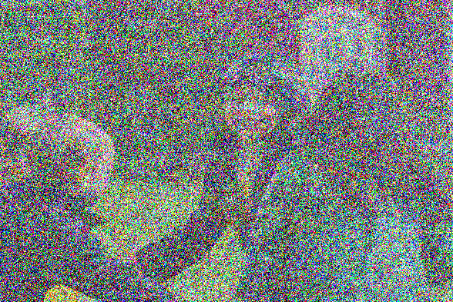
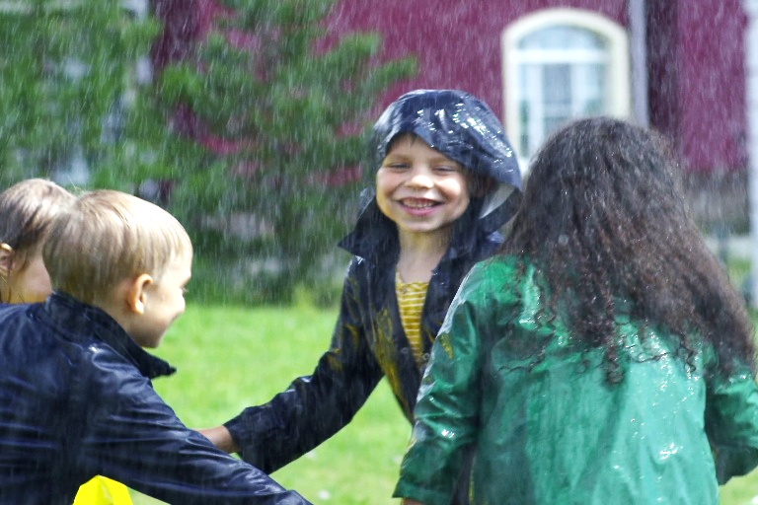
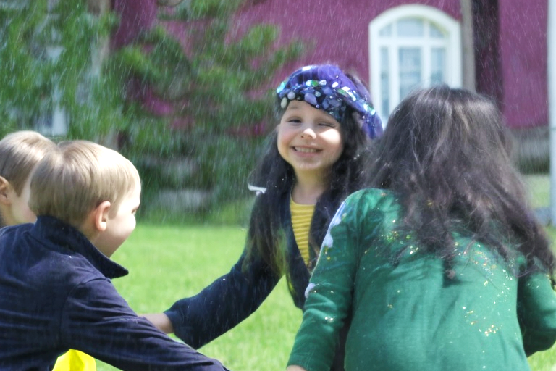
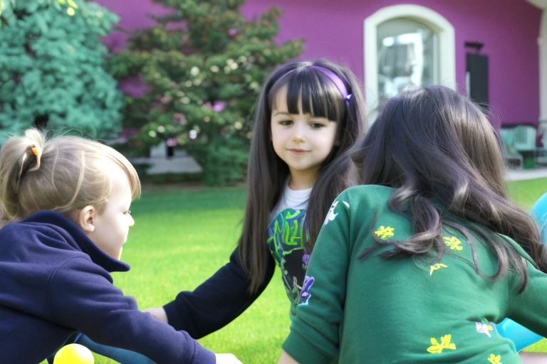
Challenge: Content Preservation
Closer to original image
Closer to pure noise
Input to SD
Degraded image (Rainy)
Output
Worse restoration
Better content preservation
Better restoration
Worse content preservation

Slide 9
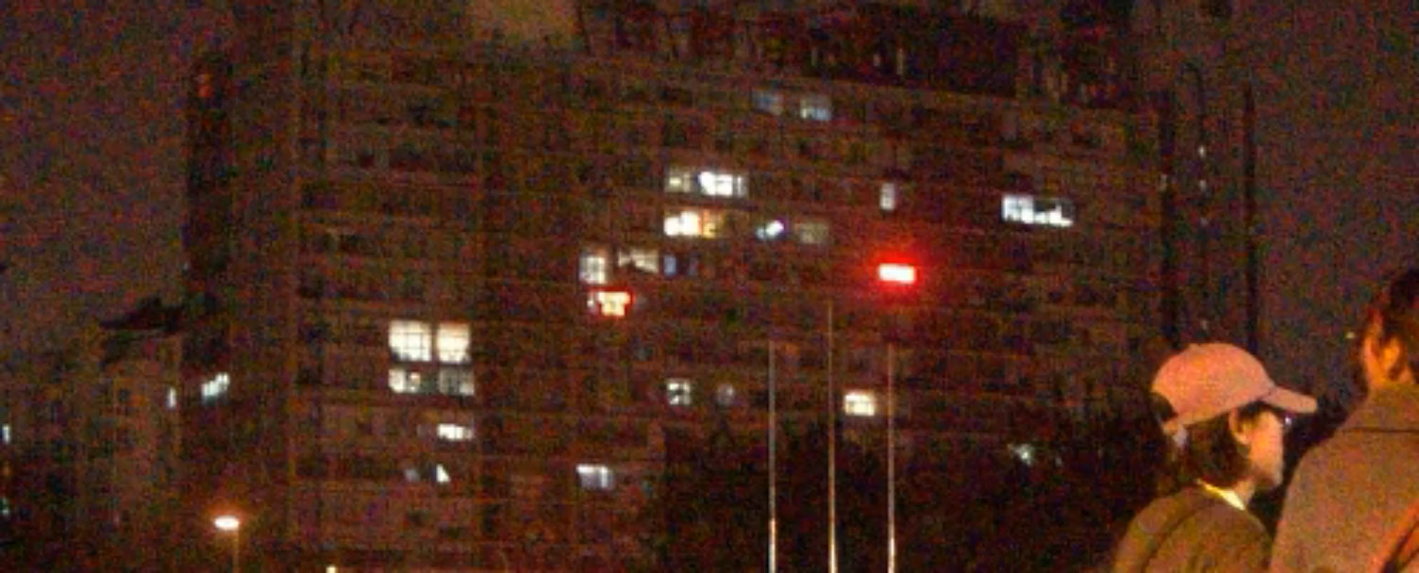
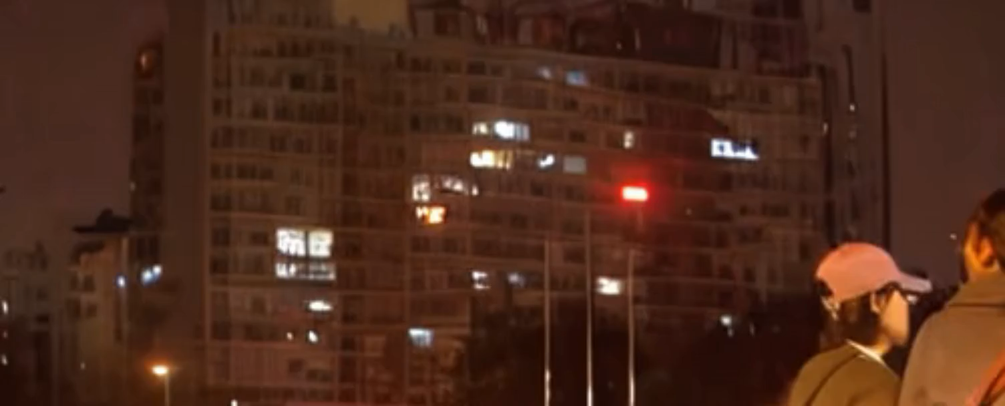
Challenge: Temporal Consistency for Video Restoration
Video denoising example
Input
Frame-by-frame Stable Diffusion
Instability and flickering artifacts -> Limited temporal consistency

Slide 10
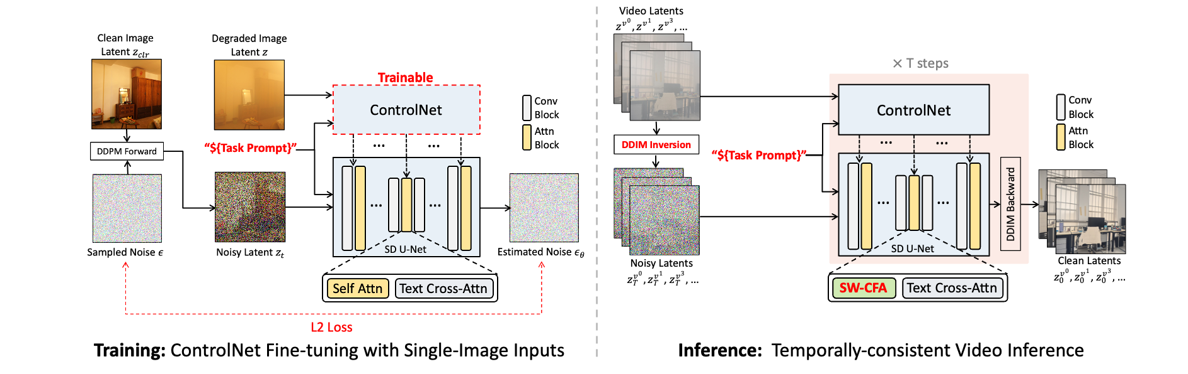
Our Training with Single-Image Inputs
- Pre-trained Stable Diffusion + Fine-tuned ControlNet (ICCV’23)

Slide 11
Our Training with Single-Image Inputs
- Pre-trained Stable Diffusion + Fine-tuned ControlNet (ICCV’23)
Not requiring videos for training
Memory efficient
(Trained on a single GPU)
Scalable to other tasks

Slide 12
Our Training with Single-Image Inputs
- Task Prompt Guidance (TPG) for all-in-one restoration

Slide 13
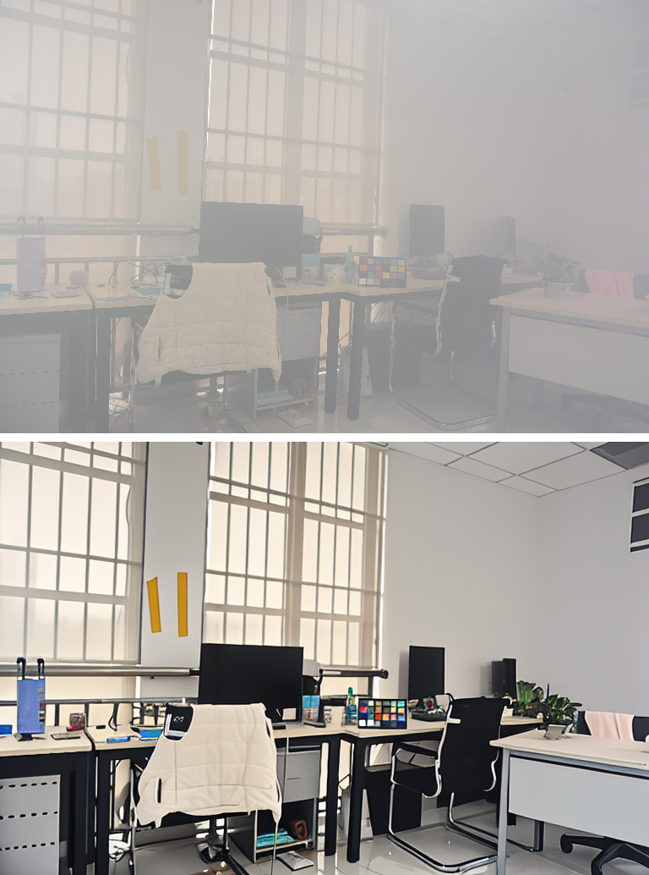
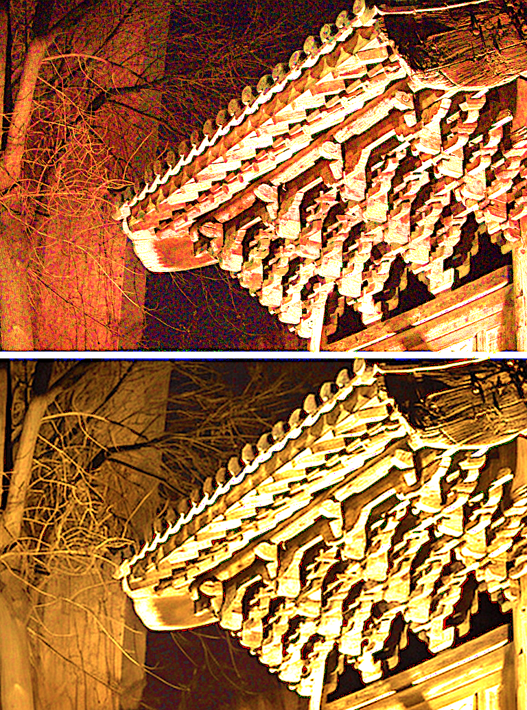
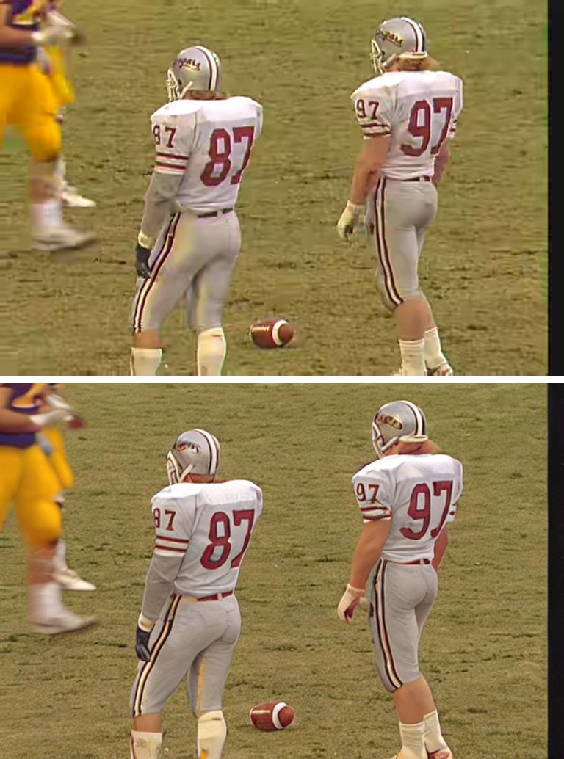
Our Single-Image-Based Training
- Task Prompt Guidance (TPG) for all-in-one restoration
“recover the high resolution details”
“remove the video compression artifacts”
“remove the fog”
“remove the rain”
“remove the noise”
Dehazing
Deraining
Denoising
Super-resolution
Comp. Artifacts

Slide 14
Our Inference with Video Frames
- Adoption of Denoising Diffusion Implicit Models (DDIM) Inversion

Slide 15
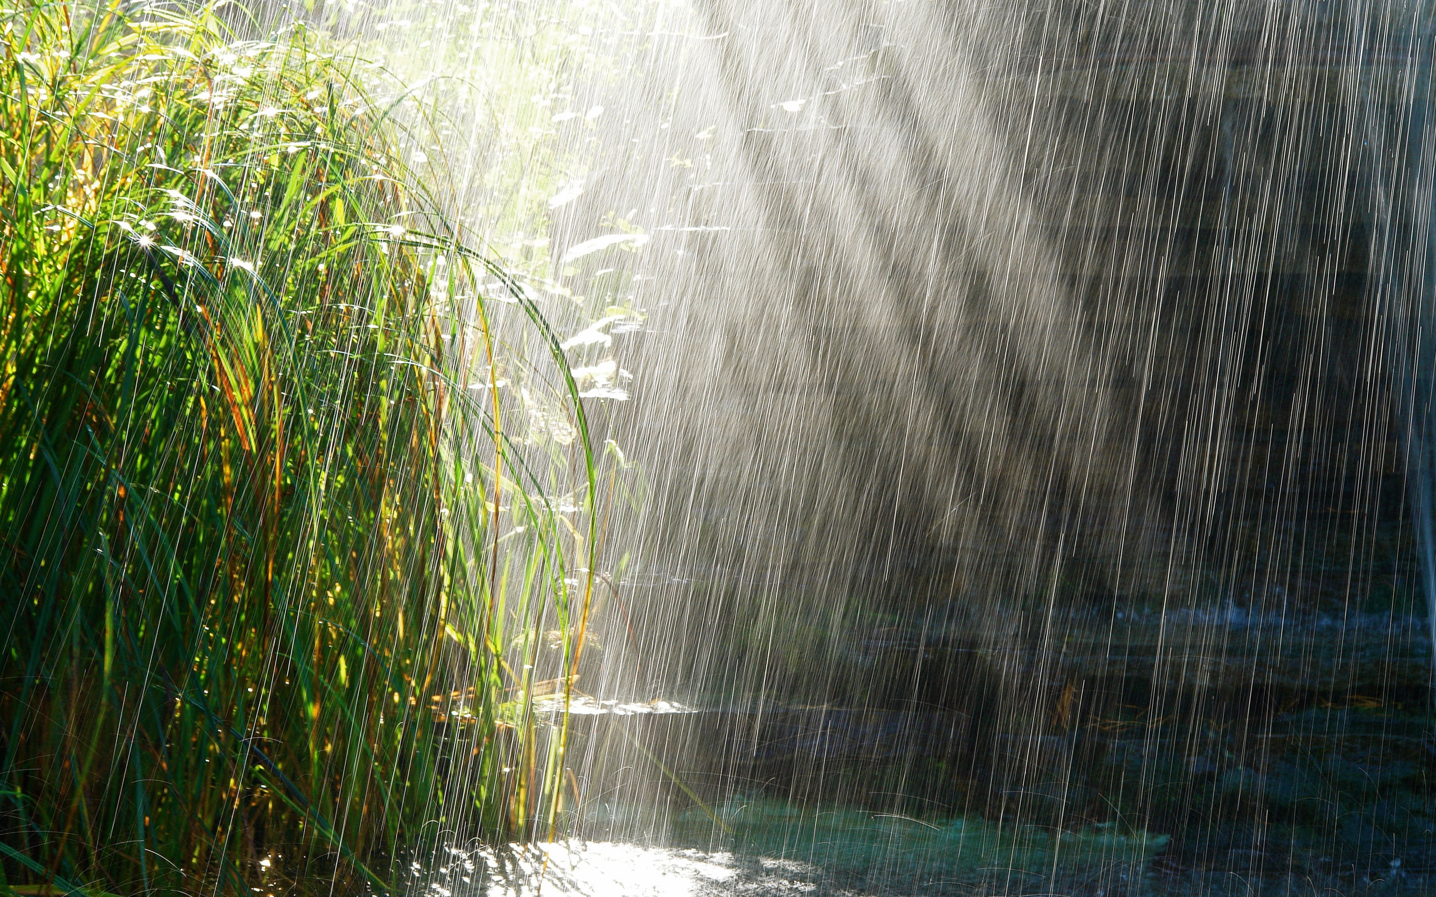
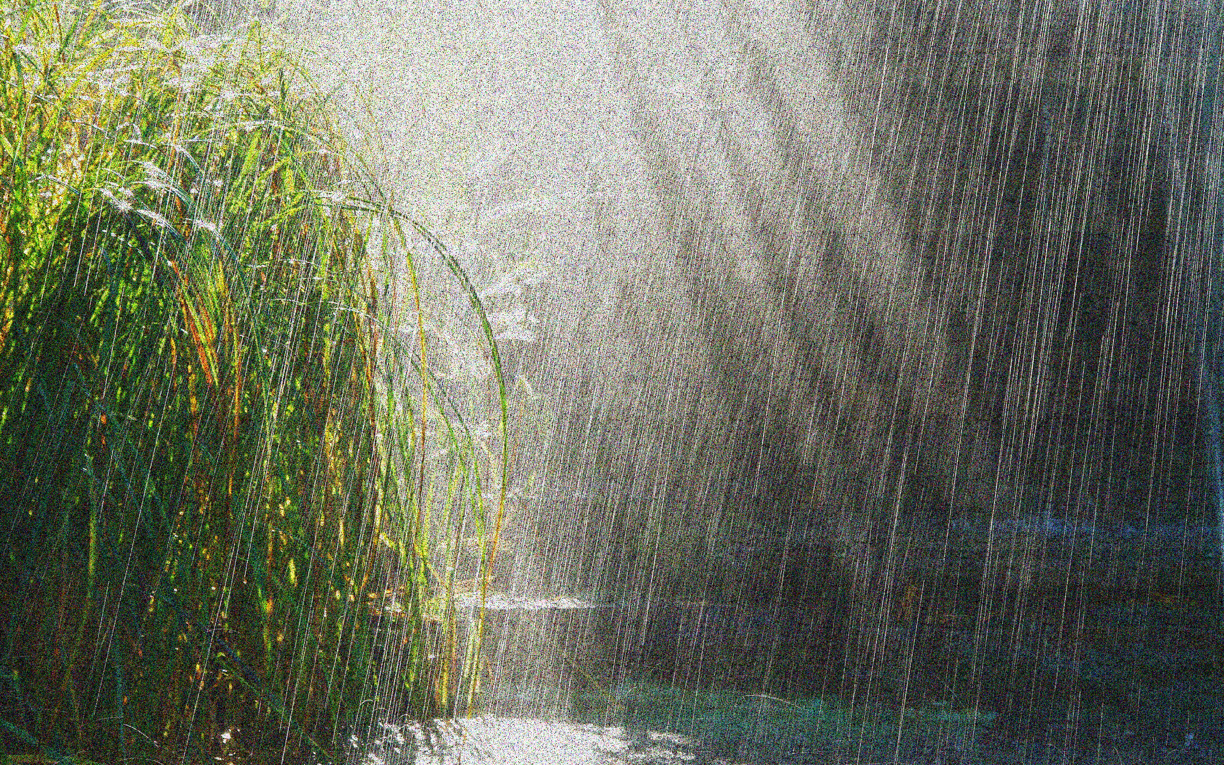



Our Inference with Video Frames
- Adoption of Denoising Diffusion Implicit Models (DDIM) Inversion
$$x_{0}$$
…
…
$$x_{1}$$
$$ε_{θ}(x_{0},0)$$
Predicted Gaussian Noise
Degraded Image
Noiser Image
Pretrained Stable Diffusion
Use the same Stable Diffusion model to predict the noise,
and ADD it to the degraded image

Slide 16
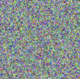



Our Inference with Video Frames
- Adoption of Denoising Diffusion Implicit Models (DDIM) Inversion
DDIM Inversion
DDIM Inversion
$$x_{0}$$
$$x_{500}$$
$$x_{T}$$
Degraded Image
A Gaussian noise, but not random

Slide 17
Our Inference with Video Frames
- Proposed Sliding-Window Cross-Frame Attention (SW-CFA)

Slide 18
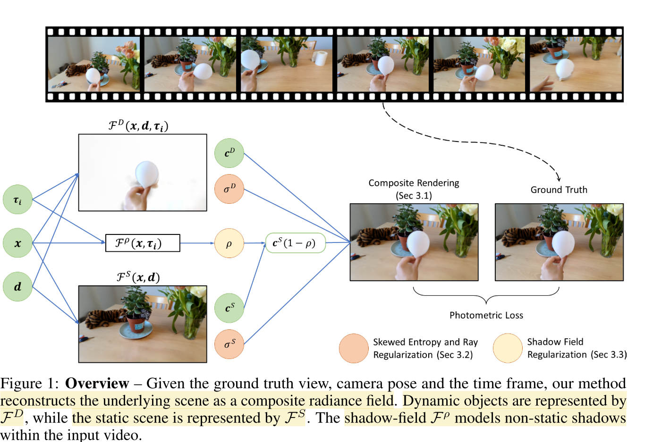
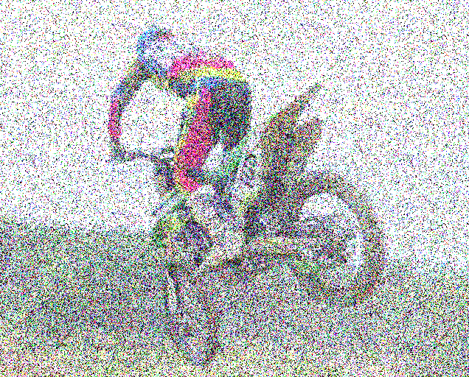
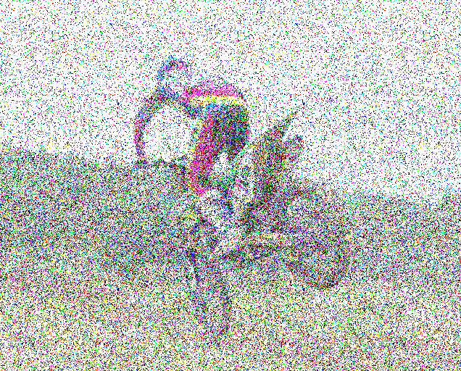
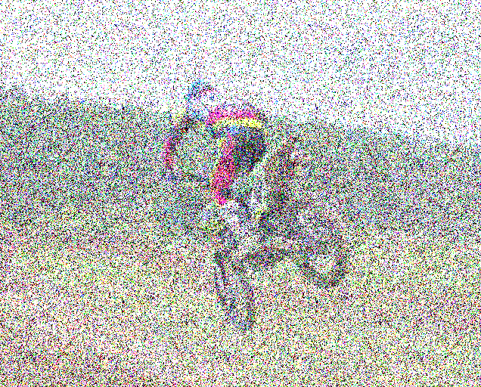
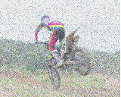







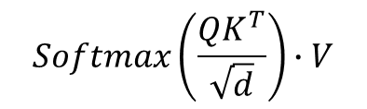


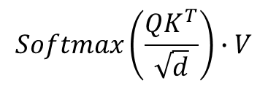








Our Inference with Video Frames
- Proposed Sliding-Window Cross-Frame Attention (SW-CFA)
…
$$z^{v_{i−1}}$$
$$z^{v_{i}}$$
$$z^{v_{i+1}}$$
…
…
$$z^{v_{i}}$$
…
Cross-frame correlation
Q: source frame
K, V: Nearby frames in a sliding window
$$W^{K}$$
$$W^{V}$$
$$W^{Q}$$
$$W^{K}$$
$$W^{V}$$
$$W^{Q}$$
$$Ks$$
$$Vs$$
…
…
…
…
…
…
Extension
Avg.
Avg.
$$K$$
$$V$$
$$Q$$
…
…
…
$$K$$
$$V$$
$$Q$$
…
…
…
$$Softmax\left(\frac{QK^{T}}{\sqrt{d}}\right)∙V$$
$$Softmax\left(\frac{QK^{T}}{\sqrt{d}}\right)∙V$$
Self-Attention
Proposed SW-CFA (e.g., N=1)

Slide 19
Summary of Our Method
For better content preservation:
ControlNet
For all-in-one restoration:
Task Prompt Guidance (TPG)
For better content preservation:
DDIM Inversion
For better temporal consistency
Sliding-Window Cross-Frame Attention (SW-CFA)

Slide 20
Experiments
- Datasets (All-in-one restoration for five tasks)
 | Dehazing | Denoising | Deraining | MP4 Compress. | Super Resolution
Train | REVIDE-inside (5091) | DAVIS (6208) | NYURain-syn (6234) | MFQEv2 (5310) | REDS (5000)
Test (Real-world) | REVIDE-inside | CVRD | NYURain-real | MFQEv2 | UDM10
The number of training images for each task is balanced.
Challenging test scenes focusing on real-world generalization performance
- Evaluation metrics
FID and KID: No-reference metrics widely used for diffusion-based image generation
Evaluating feature distribution similarity between clean images and restored images

Slide 21
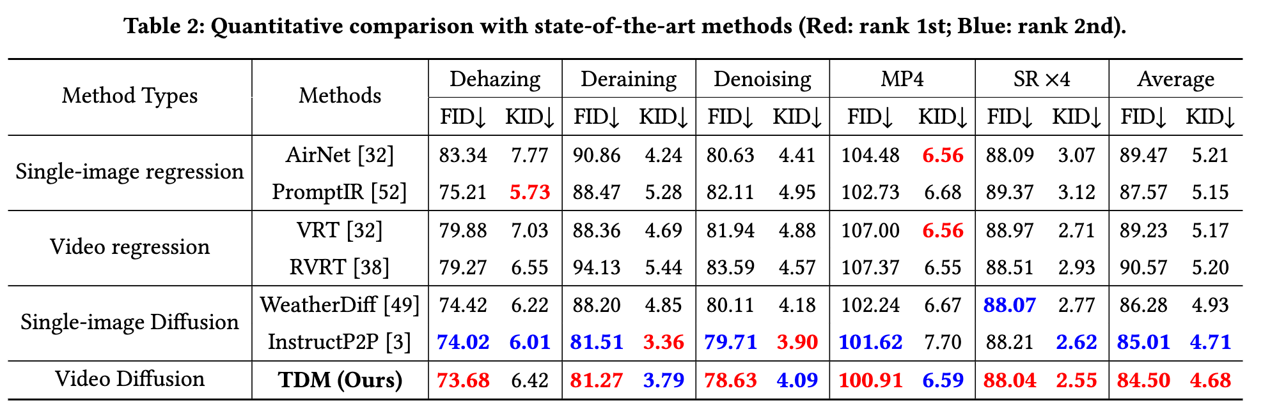
Numerical Comparisons

Slide 22
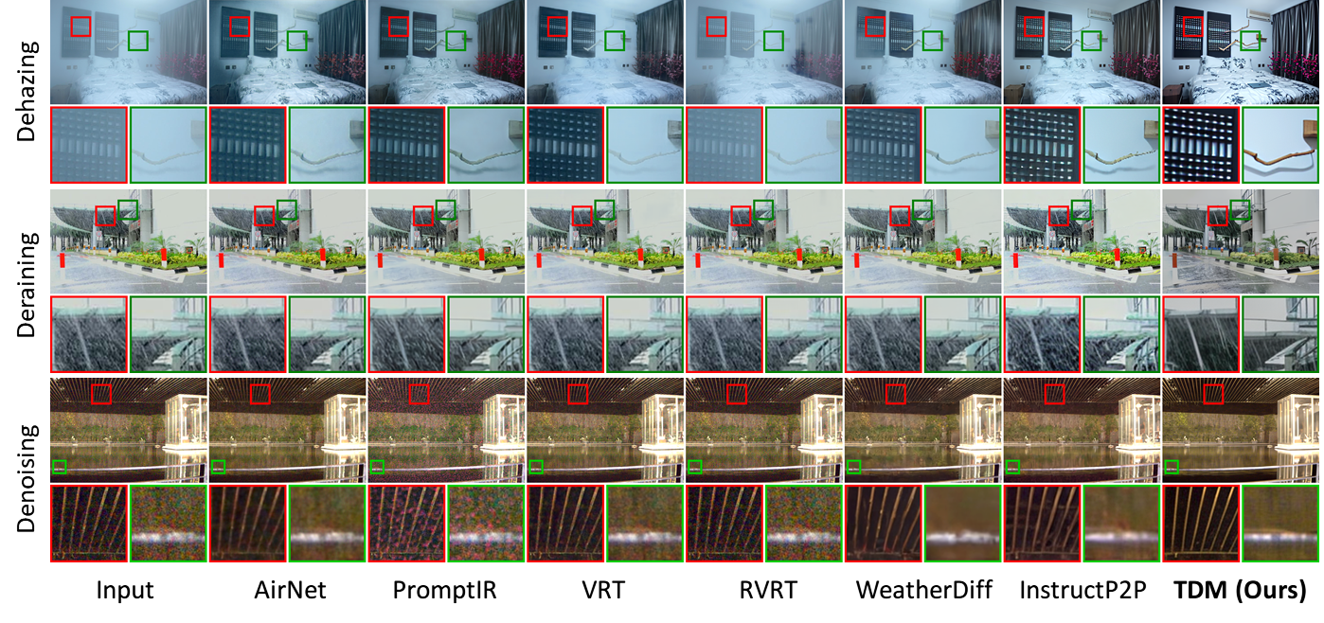
Visual Comparisons

Slide 23
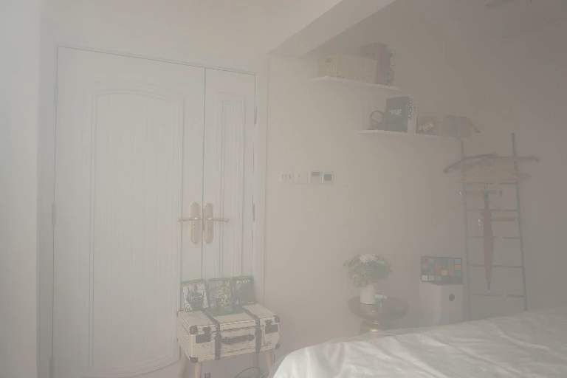
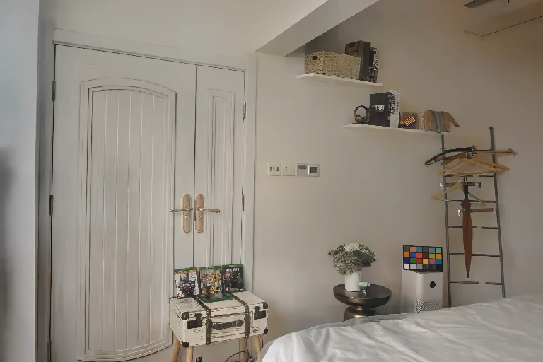
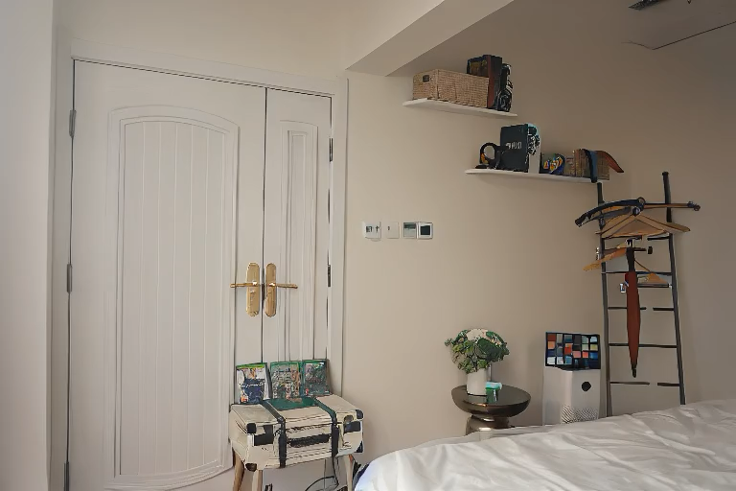
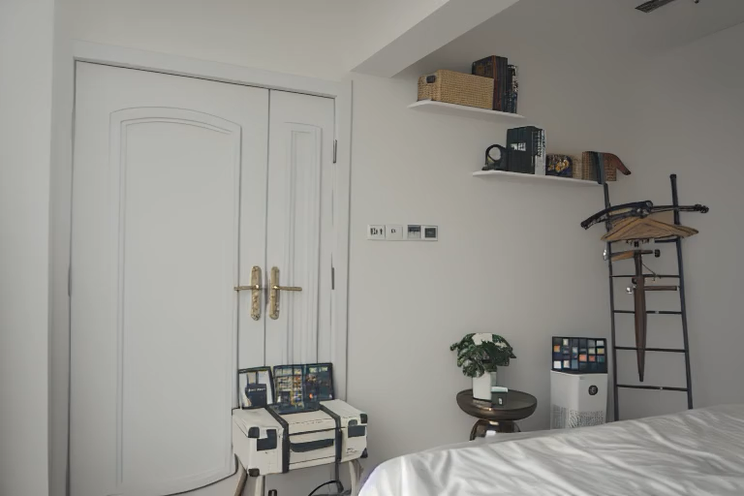
Dehazing Results
Input
WeatherDiff
InstructP2P
TDM (Ours)

Slide 24
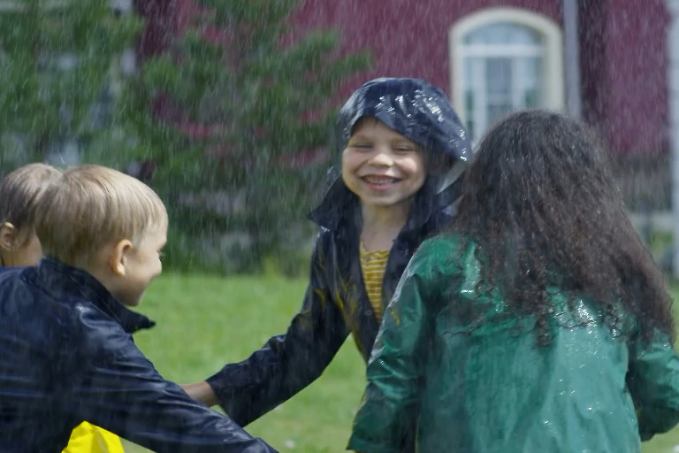


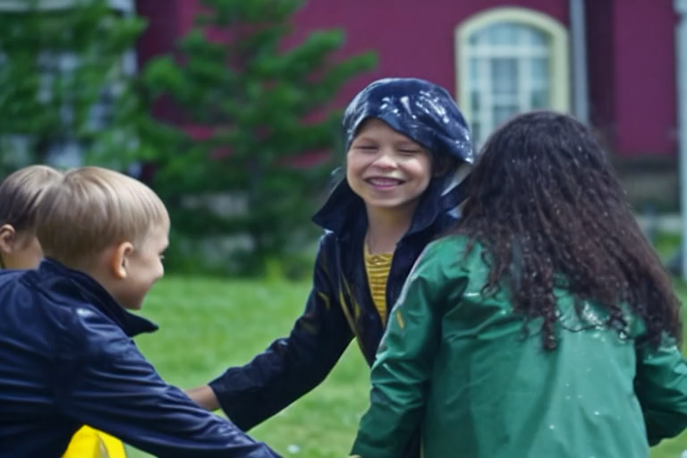
Deraining Results
Input
WeatherDiff
InstructP2P
TDM (Ours)

Slide 25

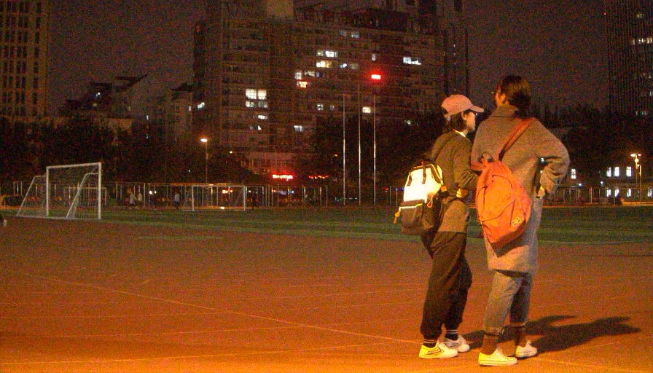


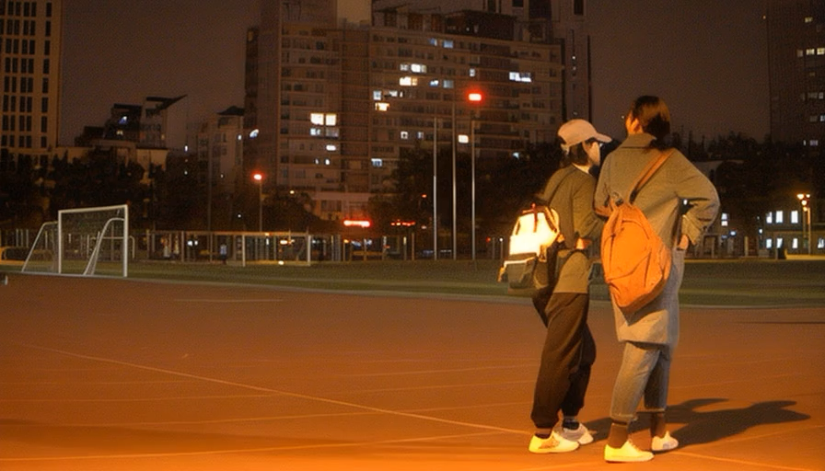
Denoising Results
Input
WeatherDiff
InstructP2P
TDM (Ours)

Slide 26

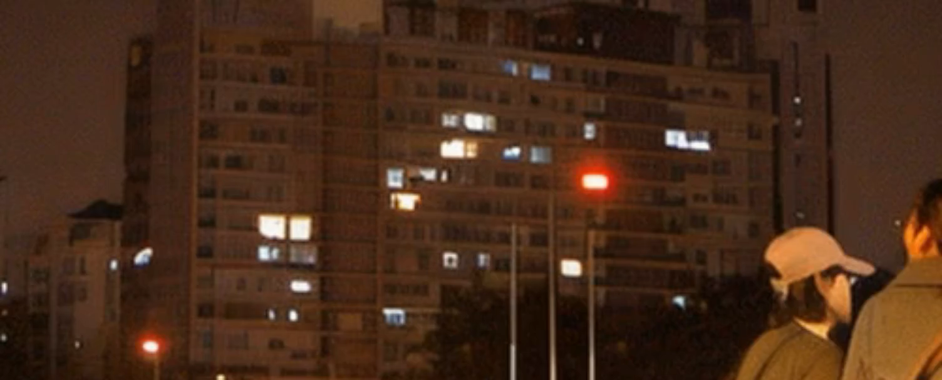
Denoising Results
Input
WeatherDiff
InstructP2P
TDM (Ours)

Slide 27

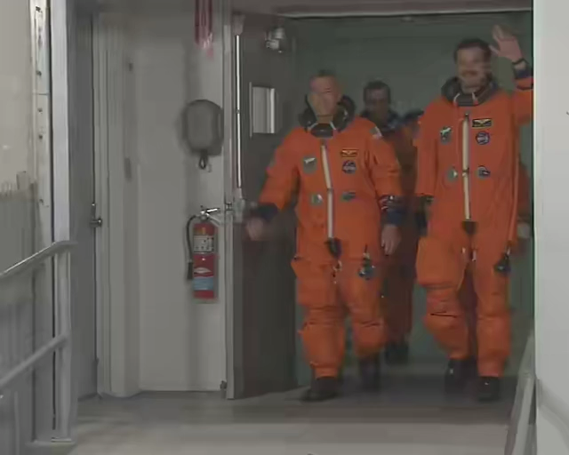
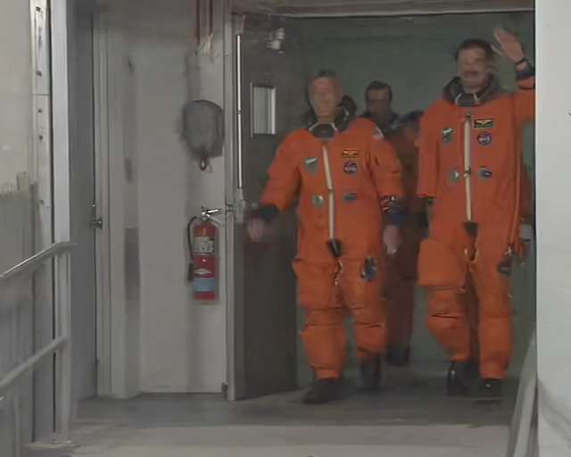
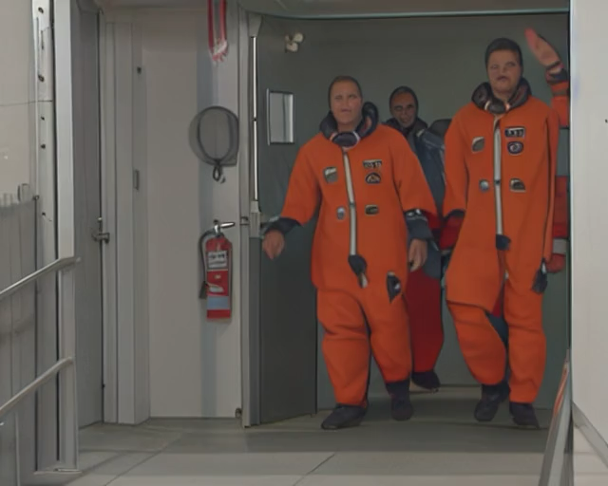
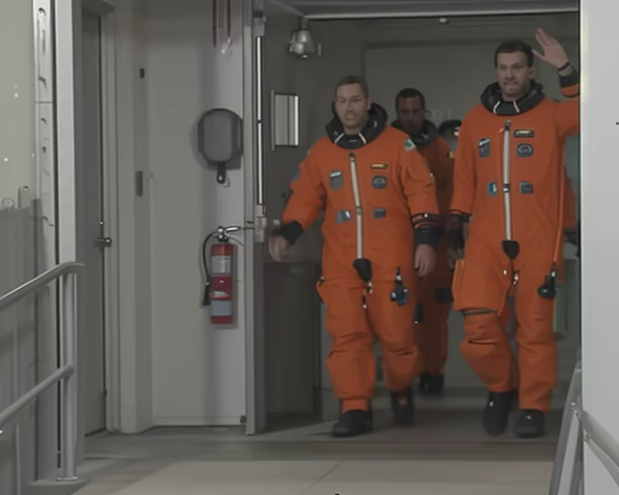
Compression Artifact Reduction Results
Input
WeatherDiff
InstructP2P
TDM (Ours)

Slide 28
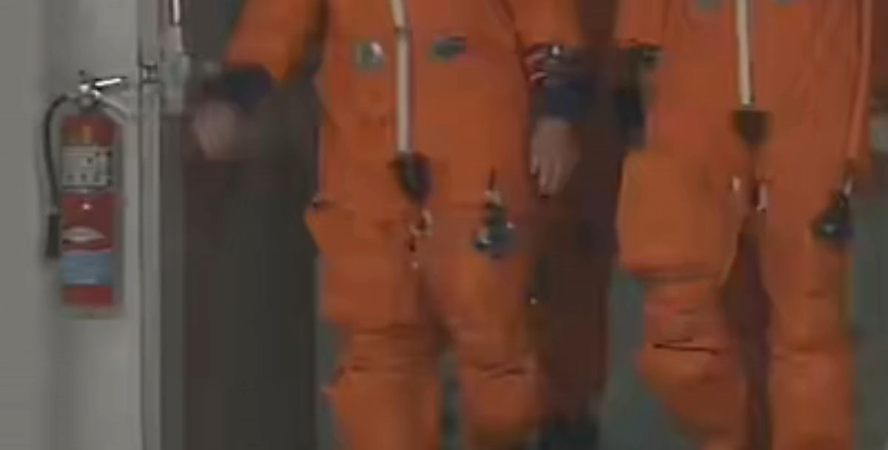
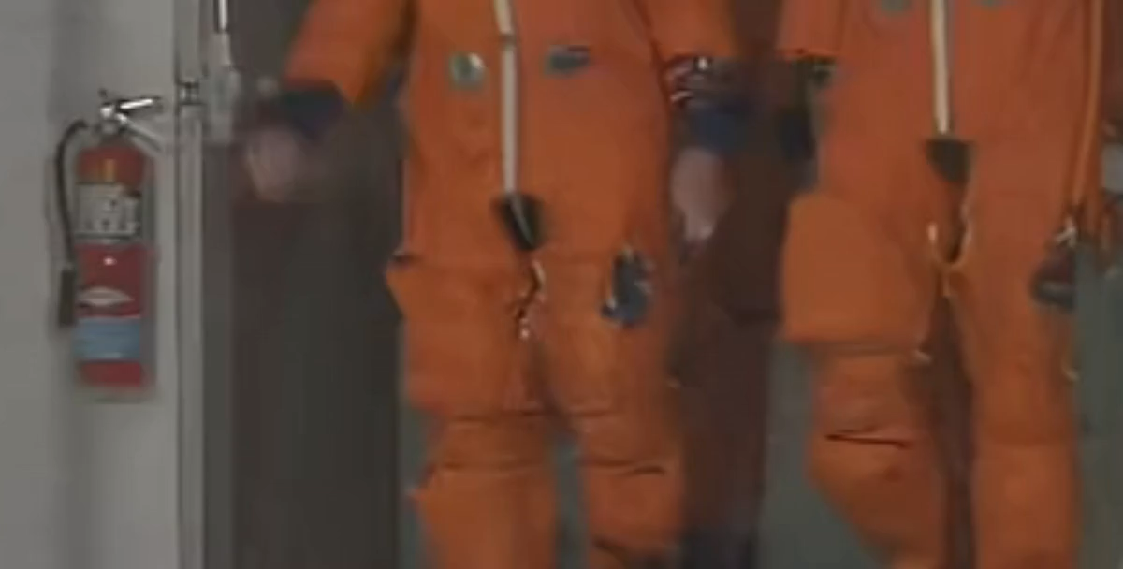
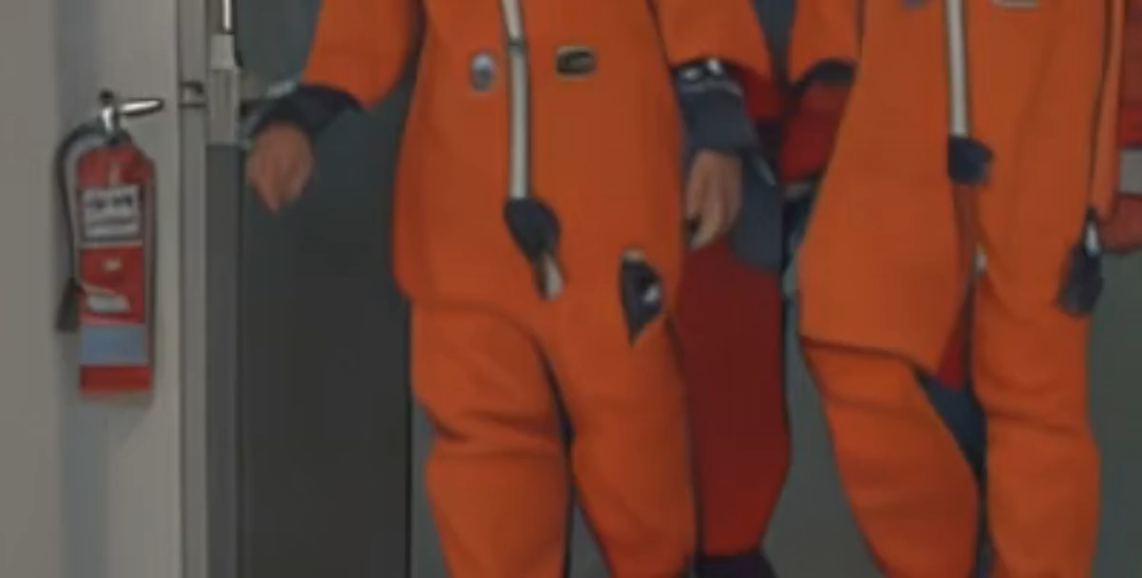
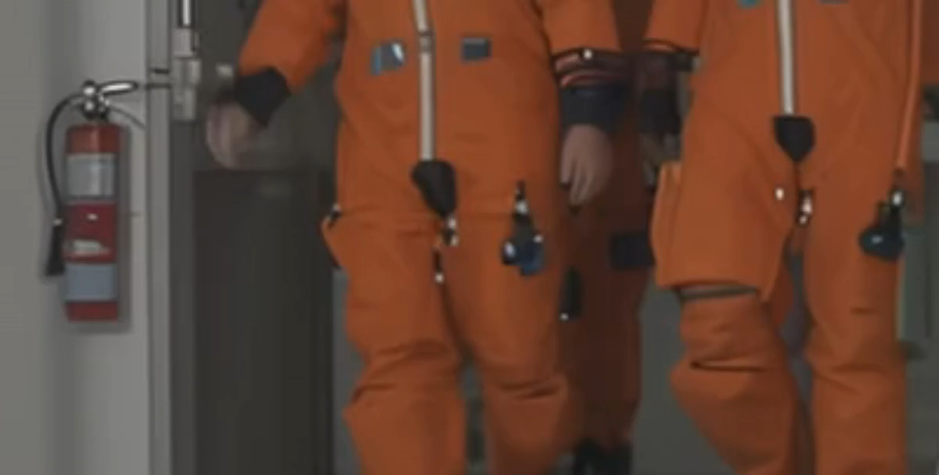
Compression Artifact Reduction Results
Input
WeatherDiff
InstructP2P
TDM (Ours)

Slide 29
Temporal Consistency Evaluation
- Evaluation metrics
Frame Consistency (FC): The average cosine similarity between consecutive frames
Warping Error (WE): The average mean squared error of consecutive frames after aligning the next frame to the current one using estimated optical flow

Slide 30
Ablation Study
TPG: Task prompt guidance
Inv.: The DDIM inversion
SW-CFA: Sliding-window cross-frame attention

Slide 31
Conclusions
We build an all-in-one video restoration diffusion model.
  – Training strategies: We achieve efficient training by fine-tuning a single ControlNet using single-image inputs without requiring video inputs.
  – Inference strategies: We incorporate DDIM Inversion and introduce a novel SW-CFA mechanism for improving content preservation and temporal consistency.
  – Scalability: Our proposed model can be trained with a single GPU and is adaptable for video inference after being trained on single-image restoration datasets.
  – Generalization performance: We demonstrated strong generalization performance of our TDM to real-world data.

Slide 32
Thank you for your listening.

