Slide 1
Remote Heart Rate Estimation
Based on 3D Facial Landmarks
Yuichiro Maki¹, Yusuke Monno¹,
Masayuki Tanaka^{1,2}, and Masatoshi Okutomi¹
¹Tokyo Institute of Technology
²National Institute of Advanced Industrial Science and Technology
International Conference of the IEEE Engineering in Medicine and Biology Society (EMBC2020)

Slide 2

Background
Cardiac information
- Heart rate (HR)
Facial video
Blood volume pulse (BVP)
Remote HR measurement from a facial video
- Non-contact measurement
- Low-cost and instant measurement
- Multiple subjects measurement

Slide 3
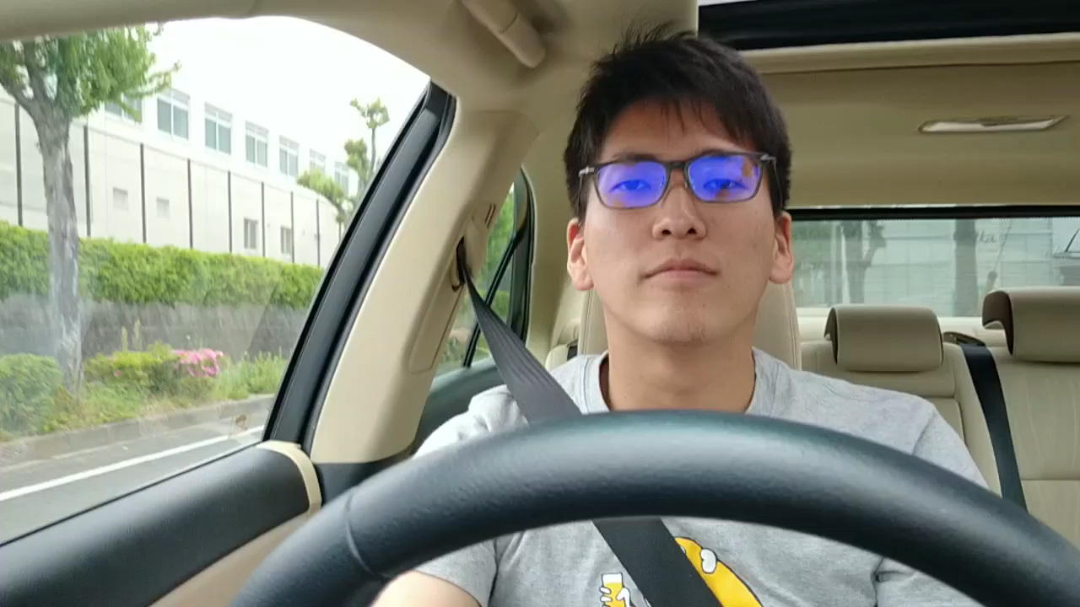
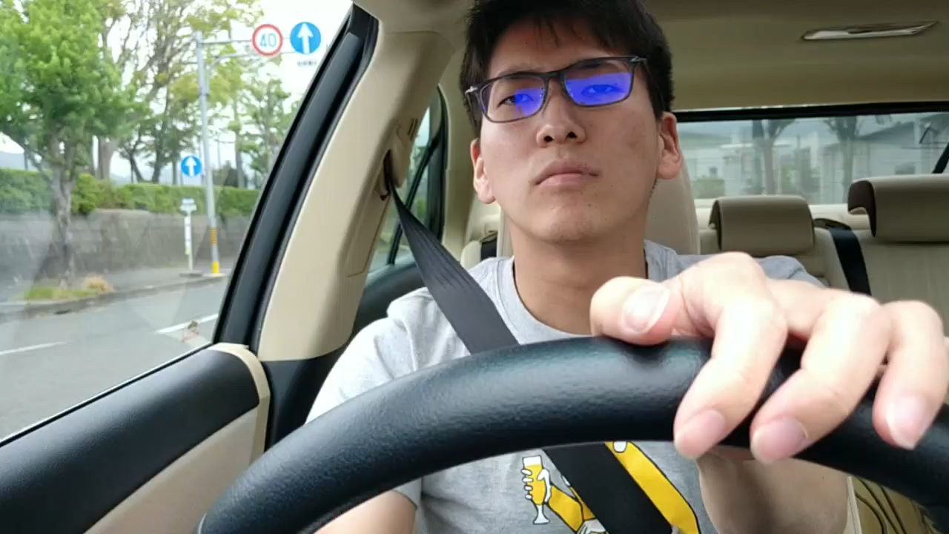
Contributions
We proposed a HR estimation method based on 3D facial landmarks.
  Increase HR estimation accuracy based on 3D facial visibility check.
  Enable to estimate HR even in facial-skin-occluded situations.
We have launched a publicly available HR estimation code.
Previous research
Our research
Considered range
of applications
Small head rotations
Large head rotations

Slide 4
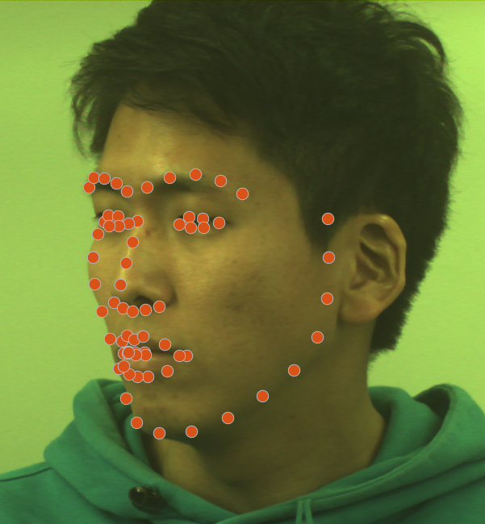
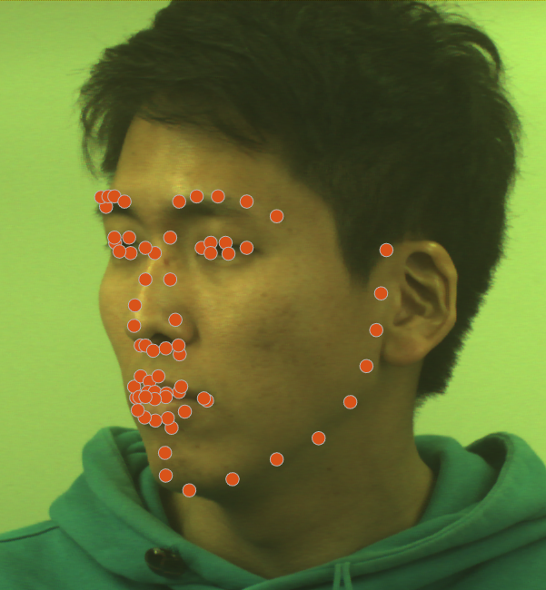
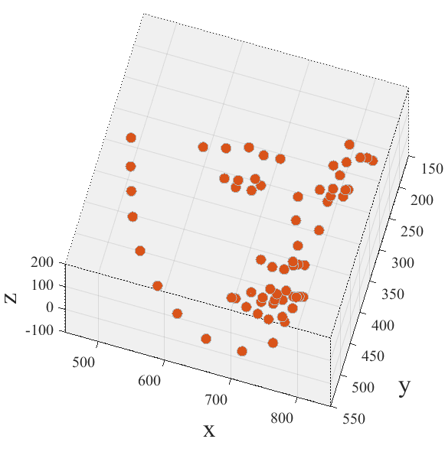
2D and 3D facial landmark detection
2D facial landmark detection
3D facial landmark detection
 | 2D facial landmark detection | 3D facial landmark detection
Represented coordinate | (x, y) image coordinate | (x, y) image and depth (z) coordinate
Facial skin occlusion | Not considered | Considered
Reference code | Nirkin et al., FG, 2018 [15]. | Bulat et al., ICCV, 2017 [13].

Slide 5
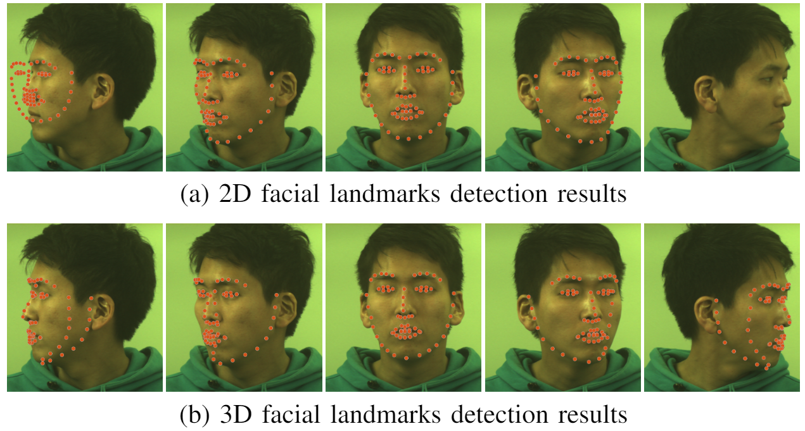
2D and 3D facial landmark detection
Limitations of 2D facial Landmarks: Weak to head rotations
Landmarks have no consistency.
Detection failure
Detection lost
Failure
No consistency
Lost
Success
Success
3D facial landmarks
detection overcomes
such limitations.

Slide 6
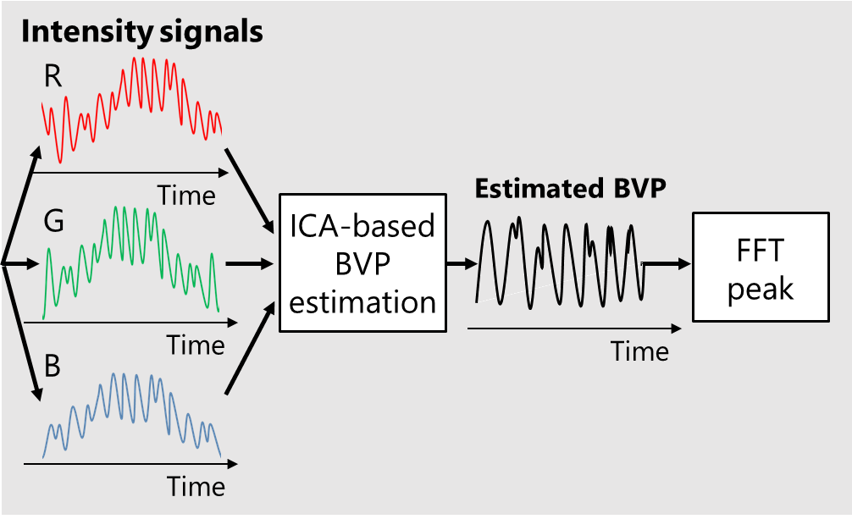

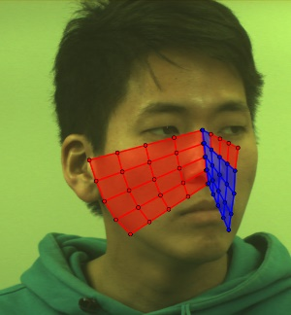

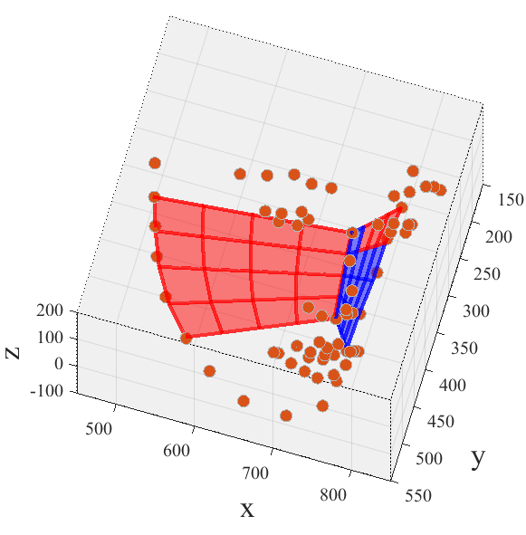
Our method flow
ICA-based HR estimation (Existing approach)
ROI
definition
HR
Input video
ROI-defined
video
3D facial
landmarks
detection
Framewise
visibility
check
Time-window
visibility
check
Temporal
smoothing
Face patch visibility mask
3D facial landmarks
Smoothed 3D
facial landmarks
Patch visibility:
Visible or Invisible

Slide 7
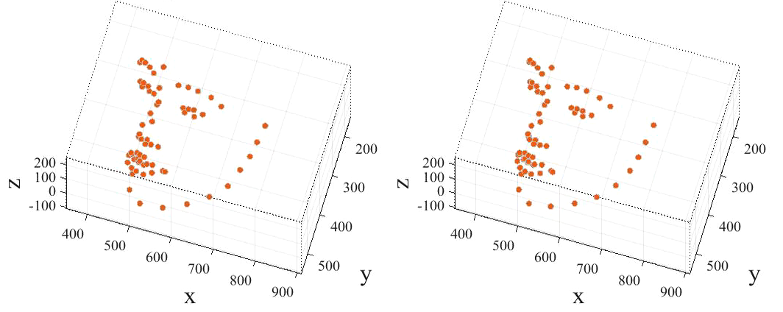
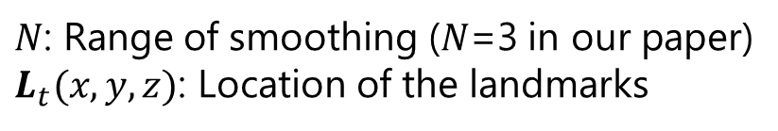

Temporal smoothing
Framewise visibility check
Temporal smoothing
Time-window visibility check
Reduce the fluctuations of the 3D landmarks.
$$L_{t}\left(x,y,z\right)=\frac{\sum_{t=t−N}^{t+N}{L_{t}\left(x,y,z\right)}}{2N+1}$$
$N$: Range of smoothing ($N$=3 in our paper)
$L_{t}(x,y,z)$: Location of the landmarks
Original landmarks
Smoothed landmarks

Slide 8
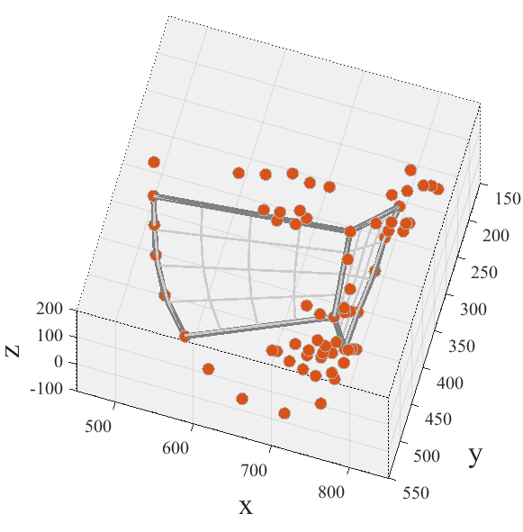
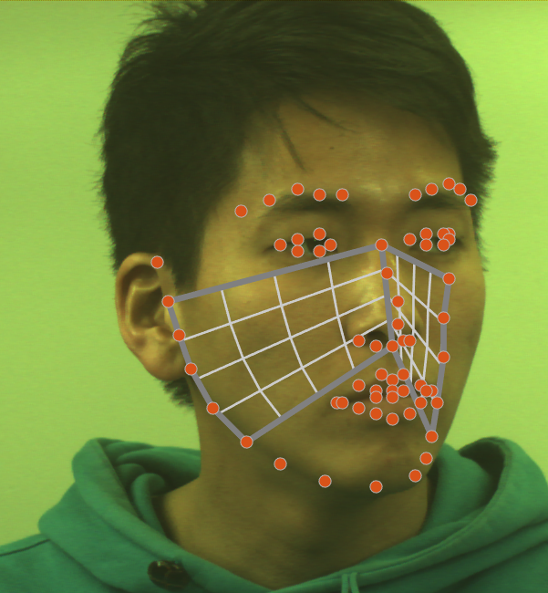
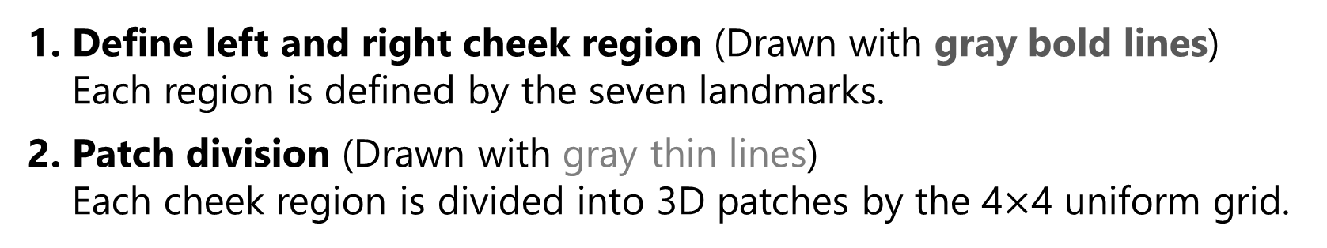
Framewise visibility | Face patch generation
Framewise visibility check
Temporal smoothing
Time-window visibility check
Define left and right cheek region (Drawn with gray bold lines)
Each region is defined by the seven landmarks.
Patch division (Drawn with gray thin lines)
Each cheek region is divided into 3D patches by the 4$×$4 uniform grid.

Slide 9
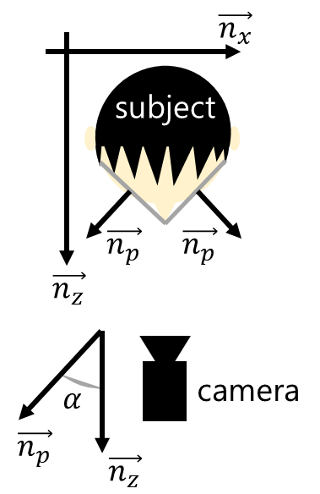
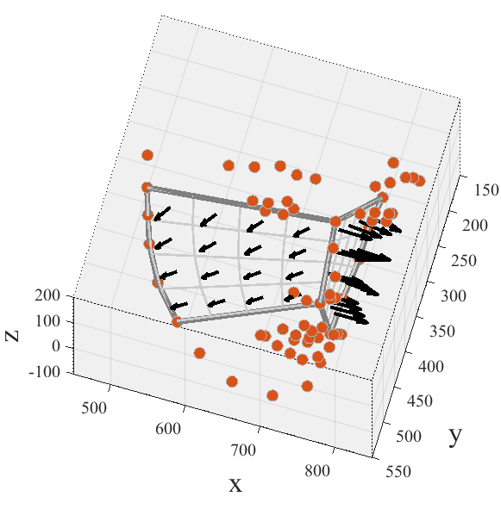
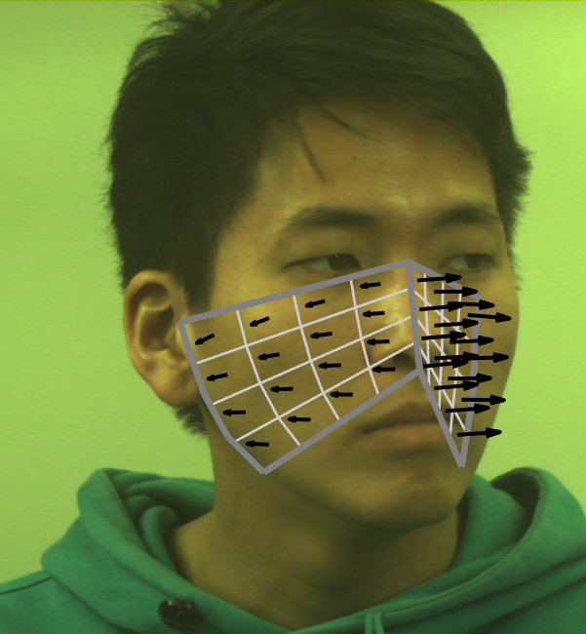
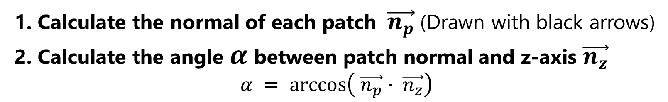
Framewise visibility | Patch visibility calculation
Framewise visibility check
Temporal smoothing
Time-window visibility check
Calculate the normal of each patch $\vec{n_{p}}$(Drawn with black arrows)
Calculate the angle $α$ between patch normal and z-axis $\vec{n_{z}}$
$$α = arccos\left( \vec{n_{p}}⋅ \vec{n_{z}}\right)$$

Slide 10
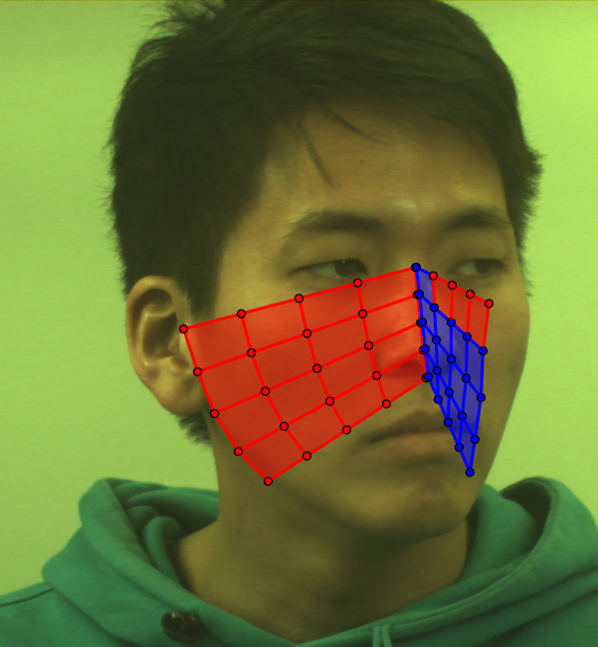

Framewise visibility | Patch visibility check
Framewise visibility check
Temporal smoothing
Time-window visibility check
Visible or Invisible
If $α$ is less than a threshold angle, the patch is visible.
- In this work, we used 75 degrees as a threshold.

Slide 11
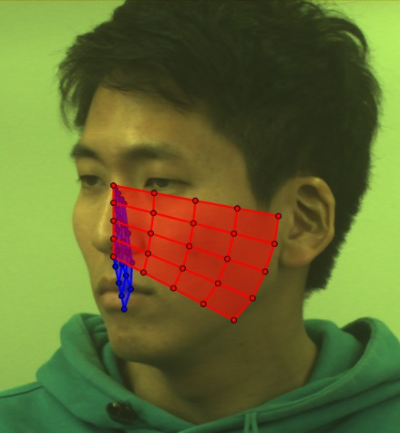
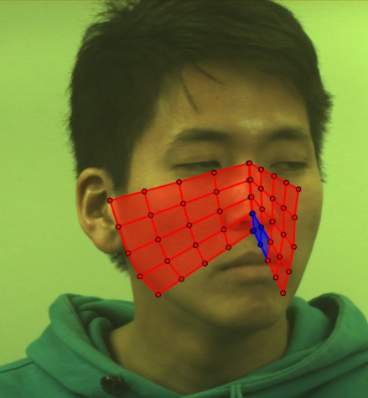
Time-window visibility check
Framewise visibility check
Temporal smoothing
Time-window visibility check
Frame 1
Frame n
Visibility mask for
a time-window
(Visible or Invisible)
0 | 0 | 0 | 0 | 1 | 1 | 1 | 1
0 | 0 | 0 | 0 | 1 | 1 | 1 | 1
0 | 0 | 0 | 0 | 1 | 1 | 1 | 1
0 | 0 | 0 | 0 | 1 | 1 | 1 | 1
1 | 1 | 1 | 1 | 1 | 1 | 1 | 1
1 | 1 | 1 | 1 | 1 | 1 | 1 | 1
1 | 1 | 1 | 1 | 1 | 1 | 1 | 1
1 | 1 | 1 | 1 | 0 | 0 | 1 | 1
0 | 0 | 0 | 0 | 1 | 1 | 1 | 1
0 | 0 | 0 | 0 | 1 | 1 | 1 | 1
0 | 0 | 0 | 0 | 1 | 1 | 1 | 1
0 | 0 | 0 | 0 | 0 | 0 | 1 | 1
…
&
&
Calculate the visibility matrices of all the frames in the time-window.
If a patch is visible in all the frames, the patch is defined as visible during the time-window.

Slide 12
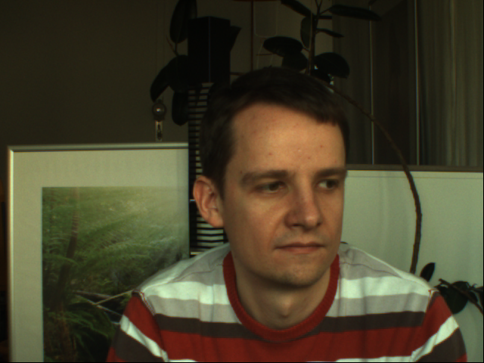
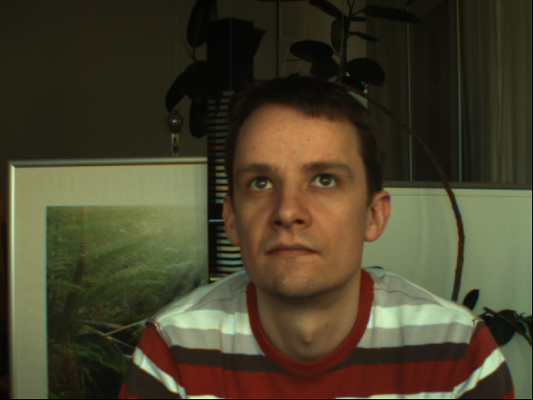
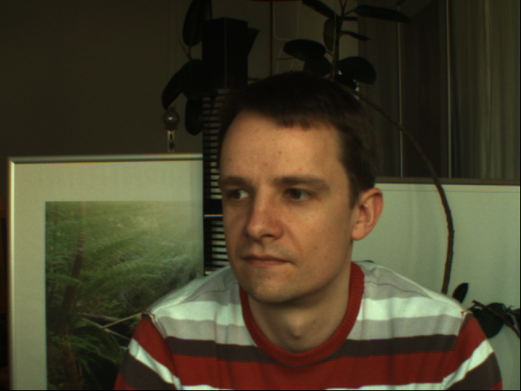
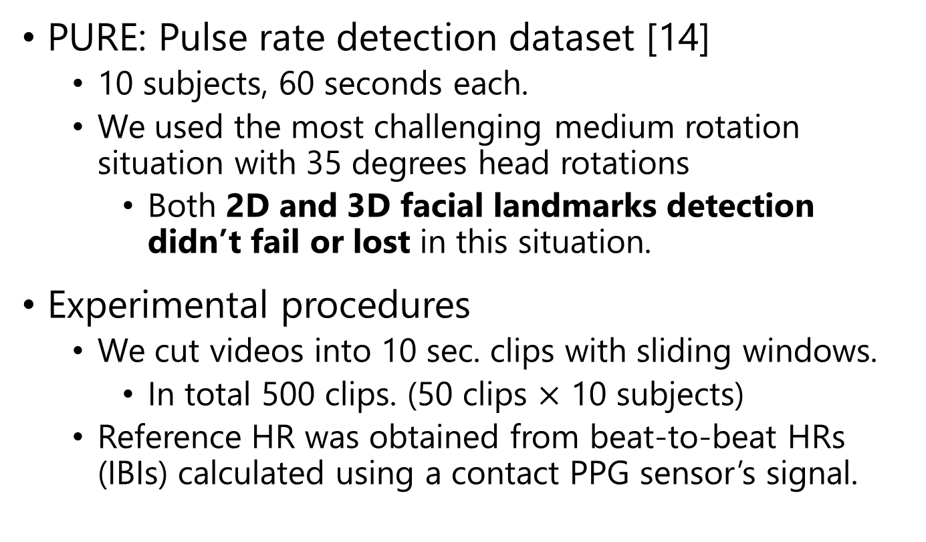
Experiments | PURE dataset
PURE: Pulse rate detection dataset [14]
  10 subjects, 60 seconds each.
  We used the most challenging medium rotation situation with 35 degrees head rotations
    Both 2D and 3D facial landmarks detection
    didn’t fail or lost in this situation.
Experimental procedures
  We cut videos into 10 sec. clips with sliding windows.
    In total 500 clips. (50 clips $×$ 10 subjects)
  Reference HR was obtained from beat-to-beat HRs (IBIs) calculated using a contact PPG sensor’s signal.
[14] R. Stricker et al., “Non-contact video-based pulse rate measurement on
a mobile service robot,” ROMAN, 2014.

Slide 13
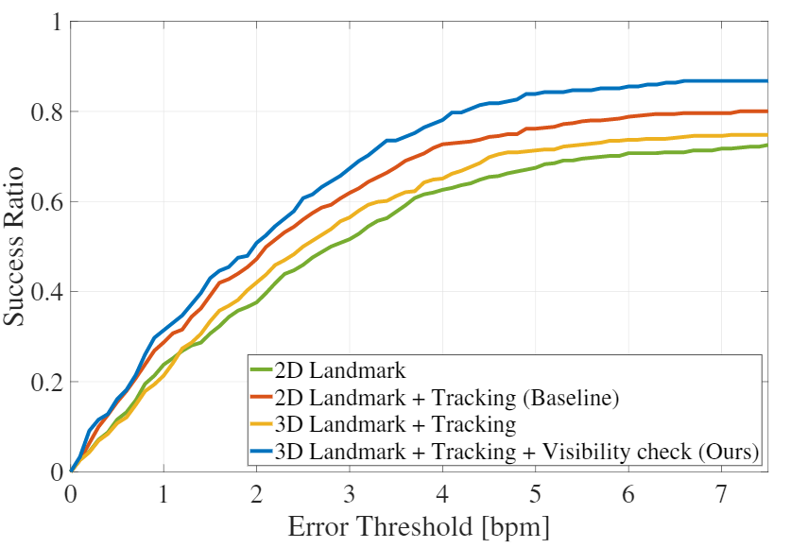

Results | PURE dataset

Slide 14
Results | PURE dataset
Improve!!
Our visibility check is effective.
Just replacing 2D with 3D is not enough.

Slide 15
Results | PURE dataset
Improve!!
Our method outperforms
the baseline method.

Slide 16
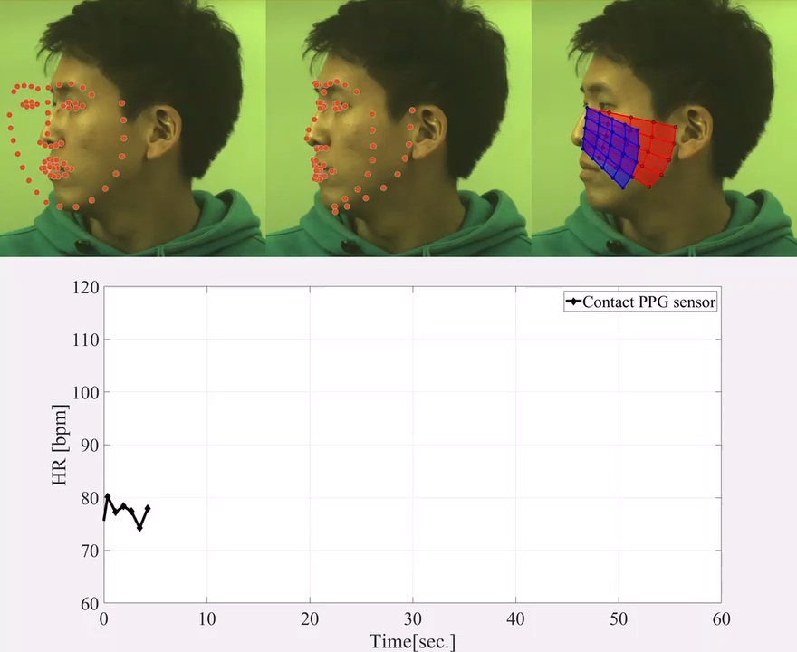
Results | Tough rotation situation
2D facial landmarks
3D facial landmarks
Framewise visibility
Our method:
Successful estimation
Baseline method:
Inaccurate estimation

Slide 17

Conclusion
Code is available.
We have proposed the first HR estimation method based on 3D facial landmarks.
We have proposed a novel face patch visibility check manner considering the 3D information.
We have experimentally demonstrated that our proposed method using the 3D landmarks outperforms the baseline method using the 2D facial landmarks.
Code is publicly available.
  http://www.ok.sc.e.titech.ac.jp/res/VitalSensing/3DfaceHR/index.html

