Slide 1
Remote heart rate measurement from RGB-NIR video
based on spatial and spectral face patch selection
Shiika Kado¹, Yusuke Monno¹, Kenta Moriwaki¹,
Kazunori Yoshizaki², Masayuki Tanaka^{1,3}, Masatoshi Okutomi¹
¹Tokyo Institute of Technology ²Olympus Corporation
³National Institute of Advanced Industrial Science and Technology

Slide 2

Background
72 BPM
Camera
Face video
Heart rate
Remote heart rate (HR) measurement from face videos
Non-contact measurement
Stress-free measurement

Slide 3
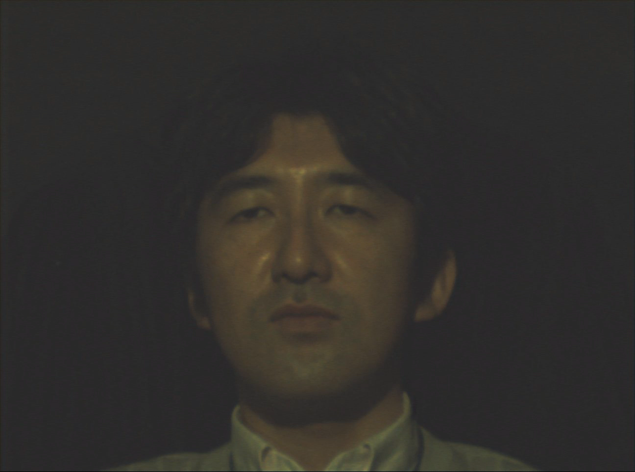
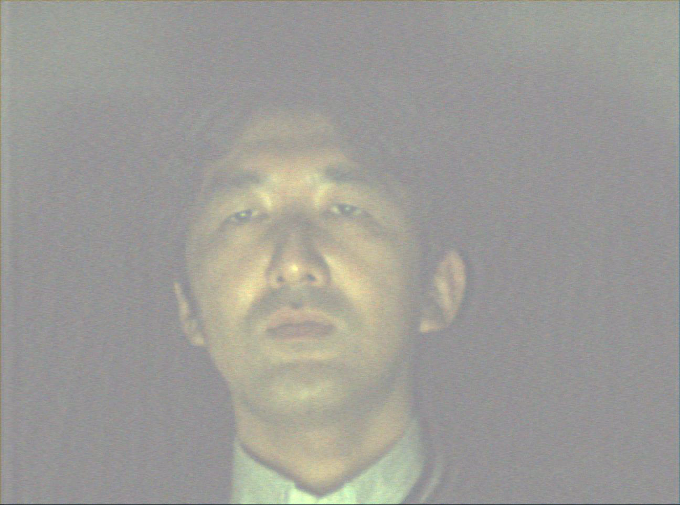
Background
Existing methods using an RGB video cannot accurately estimate HR under:
Low light
Light fluctuations
RGB video
RGB video

Slide 4
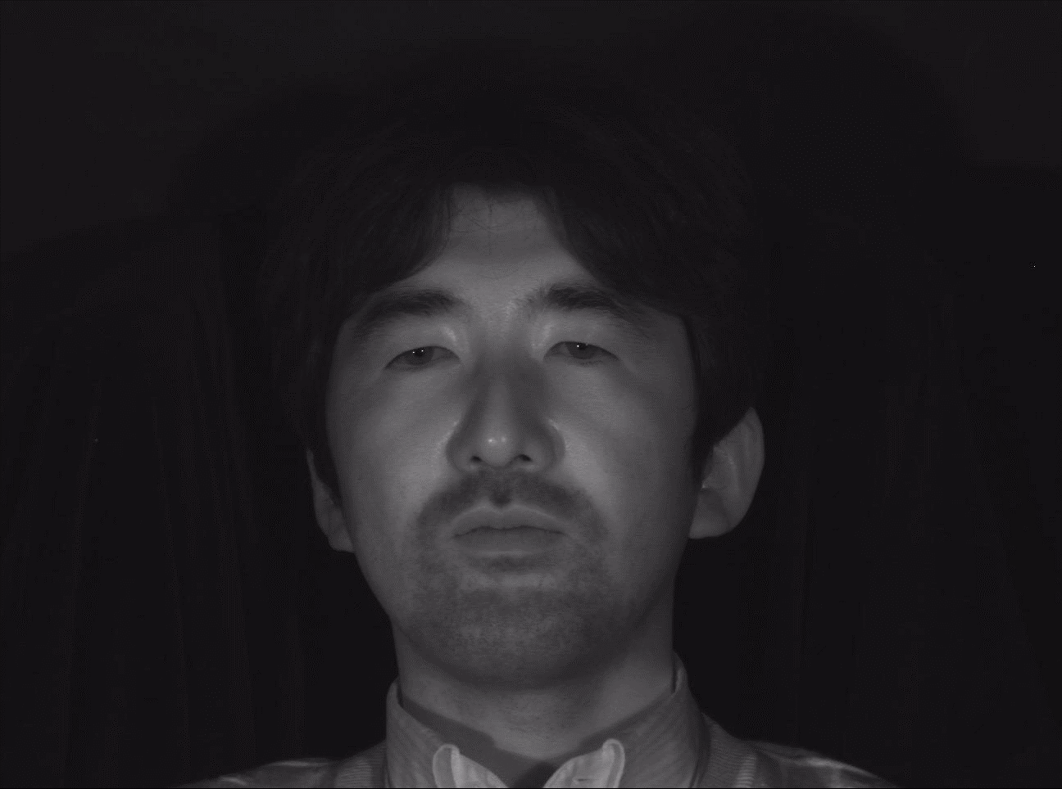
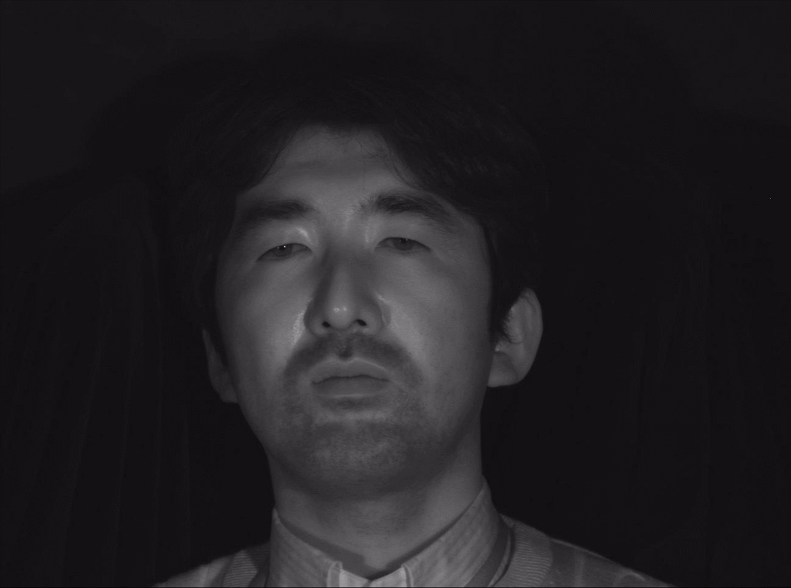
Proposed setup
Combine RGB and near-infrared (NIR) videos
to improve robustness to illumination
Low light
Light fluctuations
RGB video
NIR video
RGB video
NIR video

Slide 5
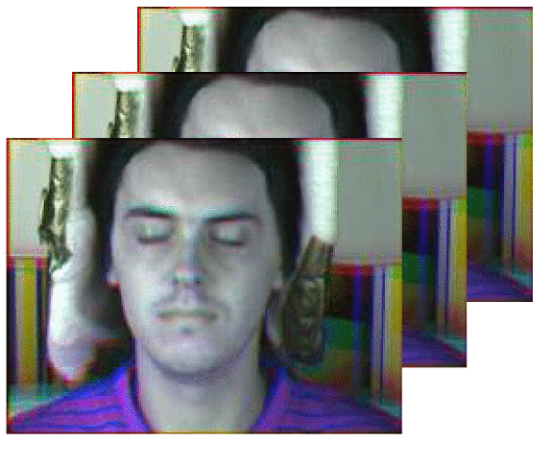
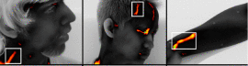
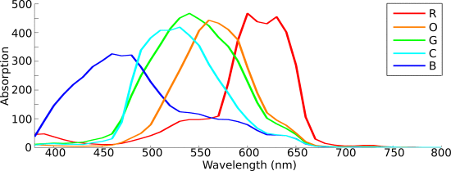
Non-RGB camera based methods
Use NIR camera
  Gastel et al., TBME, 2015
  Mitsuhashi et al., CIC, 2017
Use thermal camera
  Garbey et al., TBME, 2007
Use multispectral camera
  McDuff et al., TBME, 2014
  Guputa et al., CVPR workshop, 2016
Use RGB-NIR camera
  Proposed method
NIR camera (Gastel et al.)
Thermal camera (Garbey et al.)
Five-band camera (McDuff et al.)

Slide 6
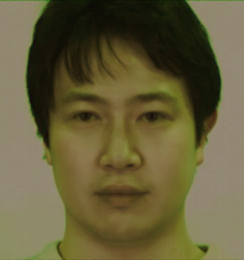
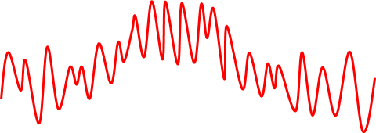
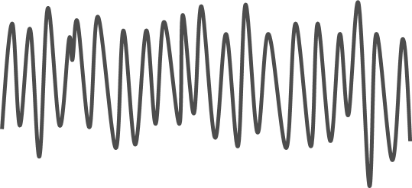
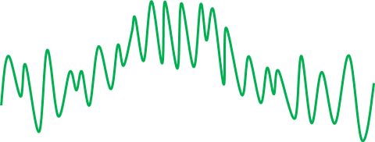
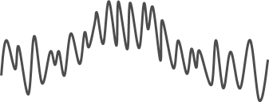
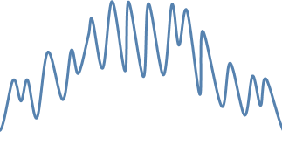
Existing algorithm using RGB camera
Poh et al., Opt. Exp., 2010
Use one face ROI and RGB channels
R channel
Average intensity
Estimated pulse signal
G channel
Time
ICA*
FFT*
Estimated
HR
B channel
Time
Time
* ICA : Independent Component Analysis
* FFT : Fast Fourier Translation
HR estimation

Slide 7
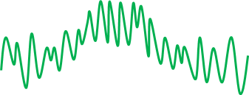
Existing algorithm using RGB camera
Lam and Kuno, ICCV, 2015
Use multiple face ROIs and the G channel
Spatial random sampling
G channel
Average intensity
HR
estimation
HR
Histogram
voting
Final
HR
HR
estimation
HR
・・・
・・・
・・・
HR
estimation
HR

Slide 8
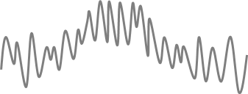

Proposed face patch sampling
Spatial and spectral sampling
Spectral
G channel
NIR channel
G
NIR
・・・
・・・
・・・
・・・
・・・
・・・
Spatial

Slide 9
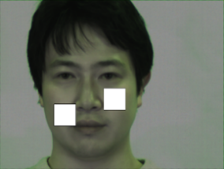
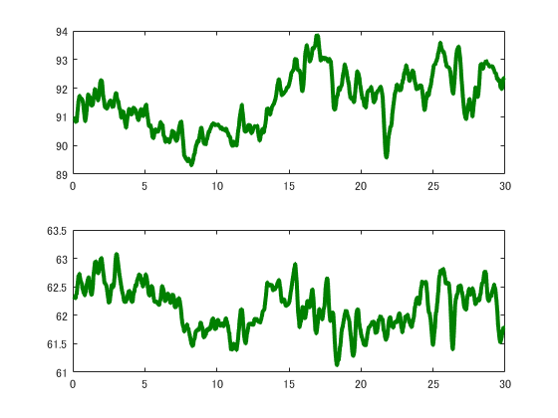
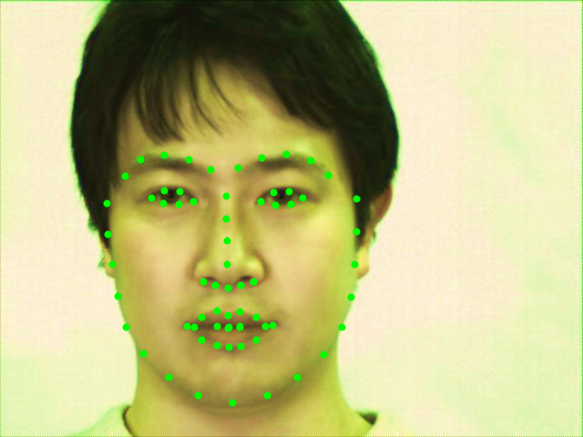
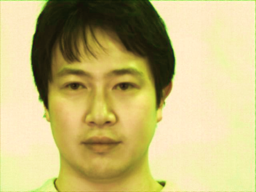
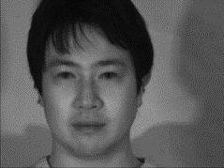
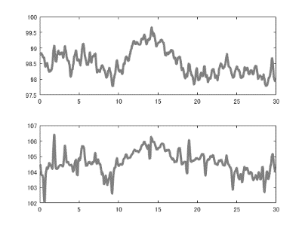
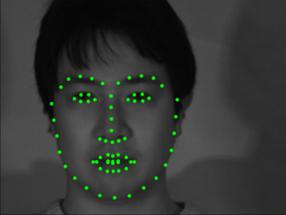
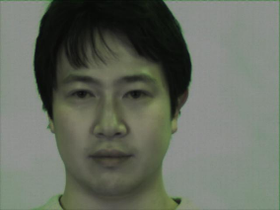
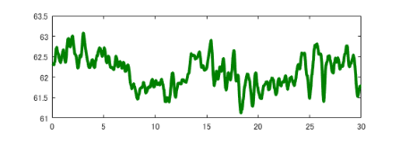






Face tracking and signal extraction
G channel
RGB-NIR video
$$t_{1}$$
$$t_{2}$$
.
Face tracking
.
$$t_{n}$$
NIR channel
Signal extraction
RGB video
$$t_{1}$$
$$t_{2}$$
.
.
Candidate HR estimation
$$t_{n}$$
Histogram voting
NIR video
Pixel value
$$t_{1}$$
$$t_{2}$$
.
.
$$t_{n}$$
Estimated HR
$$t_{1}$$
$$t_{2}$$
Time (sec)
.
Face Tracking algorithm:
.
$$t_{n}$$
KazemiIn, “One Millisecond Face Alignment with an Ensemble of Regression Trees”, CVPR, 2014

Slide 10
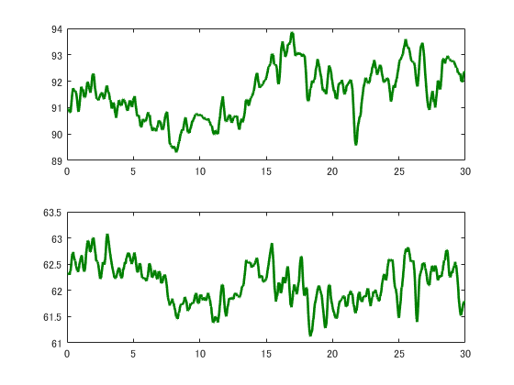
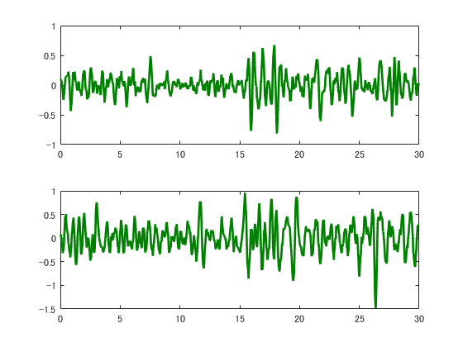
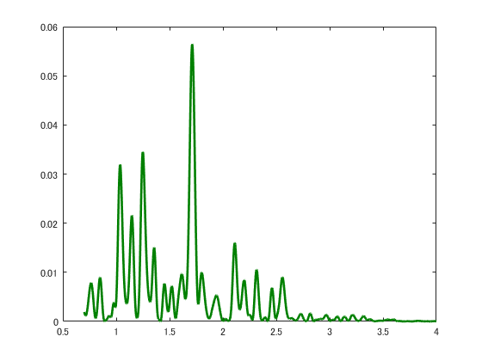


Candidate HR estimation
RGB-NIR video
(※ ICA: Independent Component Analysis)
(※ FFT: Fast Fourier Translation)
Face tracking
Signal extraction
ICA
FFT
Candidate HR estimation
Estimated pulse signal
Frequency (Hz)
Histogram voting
Most dominant frequency $f_{peak}$
Estimated HR
HR$\left(bpm\right)=60×f_{peak}(Hz)$

Slide 11


Candidate HR estimation
G channel
(i) G-G pair
RGB-NIR video
Candidate HR
Face tracking
$$t_{1}$$
$$t_{2}$$
.
.
$$t_{n}$$
NIR channel
(ii) N-N pair
Signal extraction
Candidate HR
$$t_{1}$$
$$t_{2}$$
.
Candidate HR estimation
.
$$t_{n}$$
(iii) G-N pair
Histogram voting
$$t_{1}$$
Candidate HR
$$t_{2}$$
.
.
$$t_{n}$$
Estimated HR
$$t_{1}$$
$$t_{2}$$
.
.
$$t_{n}$$

Slide 12
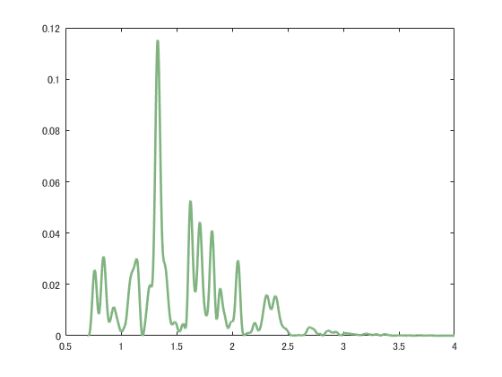
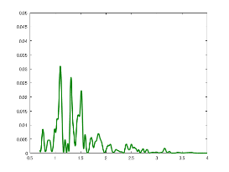









Histogram voting
Reliability check
RGB-NIR video
$r>threshold$
Reliability :
$r=\frac{V_{1}}{V_{2}}$
$$V_{1}$$
Face tracking
$$V_{2}$$
Power spectrum
Signal extraction
Reliable
$$V_{1}$$
Candidate HR estimation
$$V_{2}$$
$r<threshold$
Histogram voting
$$V_{1}$$
$$V_{2}$$
Frequency (Hz)
Estimated HR
Unreliable

Slide 13

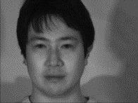
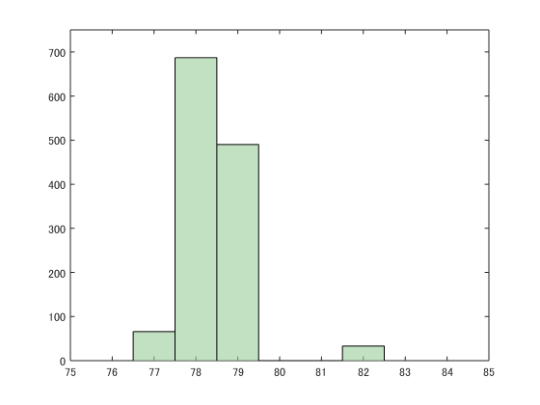
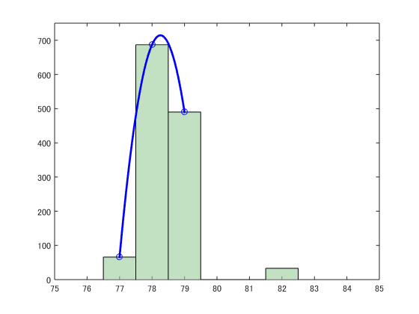
Histogram voting
RGB-NIR video
Repeat 500 times
Reliable
G-G pair
HR (78.49)
Face tracking
Unreliable
N-N pair
HR (52.21)
Voting
G-N pair
HR (78.16)
Signal extraction
Reliable
Count
Voting
G-G pair
HR (79.32)
N-N pair
HR (76.77)
Candidate HR estimation
G-N pair
HR (78.08)
・
・
・
Voting
Histogram voting
78.26
HR (BPM)
G-G pair
HR (93.85)
Parabola fitting
Estimated HR
N-N pair
HR (82.13)
G-N pair
HR (77.61)

Slide 14
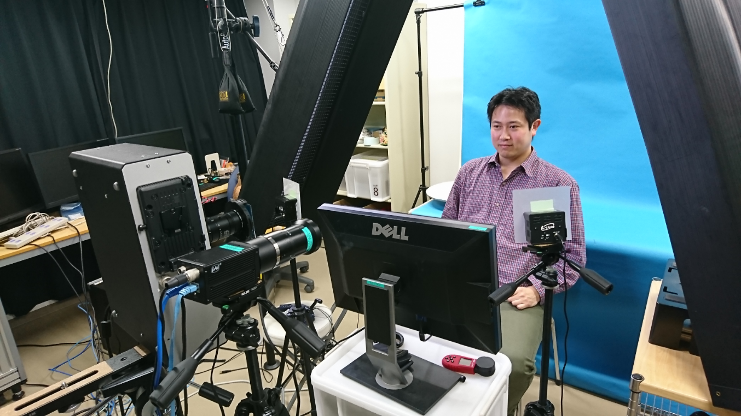
Experimental setup
20 subjects 30 seconds
Under 4 illumination conditions
Reference HR is recorded by contact PPG sensor
Fluorescent (FL)
light
NIR light
Dual CCD
RGB-NIR
camera
Display monitor

Slide 15
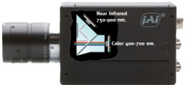
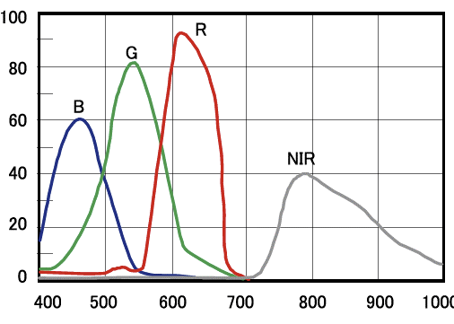
RGB-NIR camera
Used an RGB-NIR camera
to record RGB and NIR videos simultaneously
Dual CCD RGB-NIR camera
RGB sensor
Beam splitter
Sensitivity
NIR sensor
Wavelength (nm)
Sensor sensitivity
AD-130GE, JAI Ltd., Japan. http://www.jai.com/en/products/ad-130ge.

Slide 16
Compared methods
Compared with following methods:
  Poh et al., Opt. Exp., 2010
  Lam and Kuno, ICCV, 2015
Methods | Random ROI sampling | Channels
 |  | R | G | B | NIR
Poh-RGB |  | ✔ | ✔ | ✔
Poh-RGBN |  | ✔ | ✔ | ✔ | ✔
Lam-G | ✔ |  | ✔
Lam-NIR | ✔ |  |  |  | ✔
Proposed | ✔ |  | ✔ |  | ✔

Slide 17
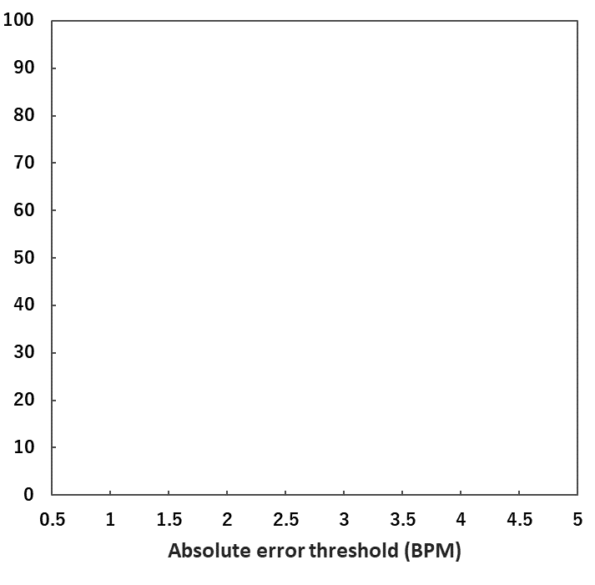
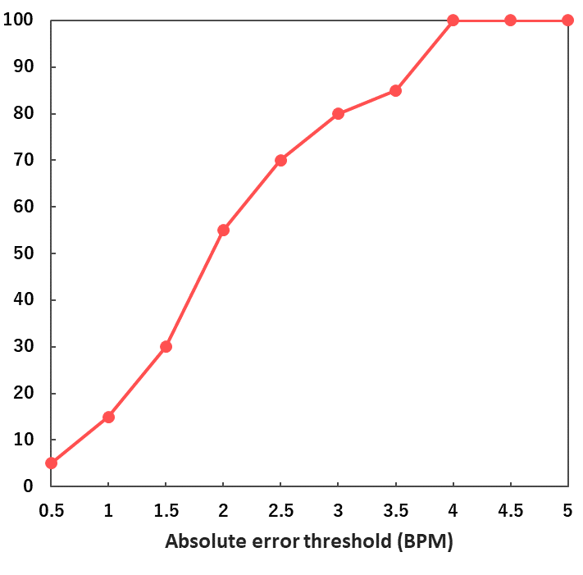
Evaluation metric
Evaluated percentage of subjects whose absolute HR estimation error is less than threshold
Good
Absolute error < 3 BPM
for 80% of subjects
Percentage of subjects
that error < threshold (%)
Bad
Absolute error threshold (BPM)

Slide 18
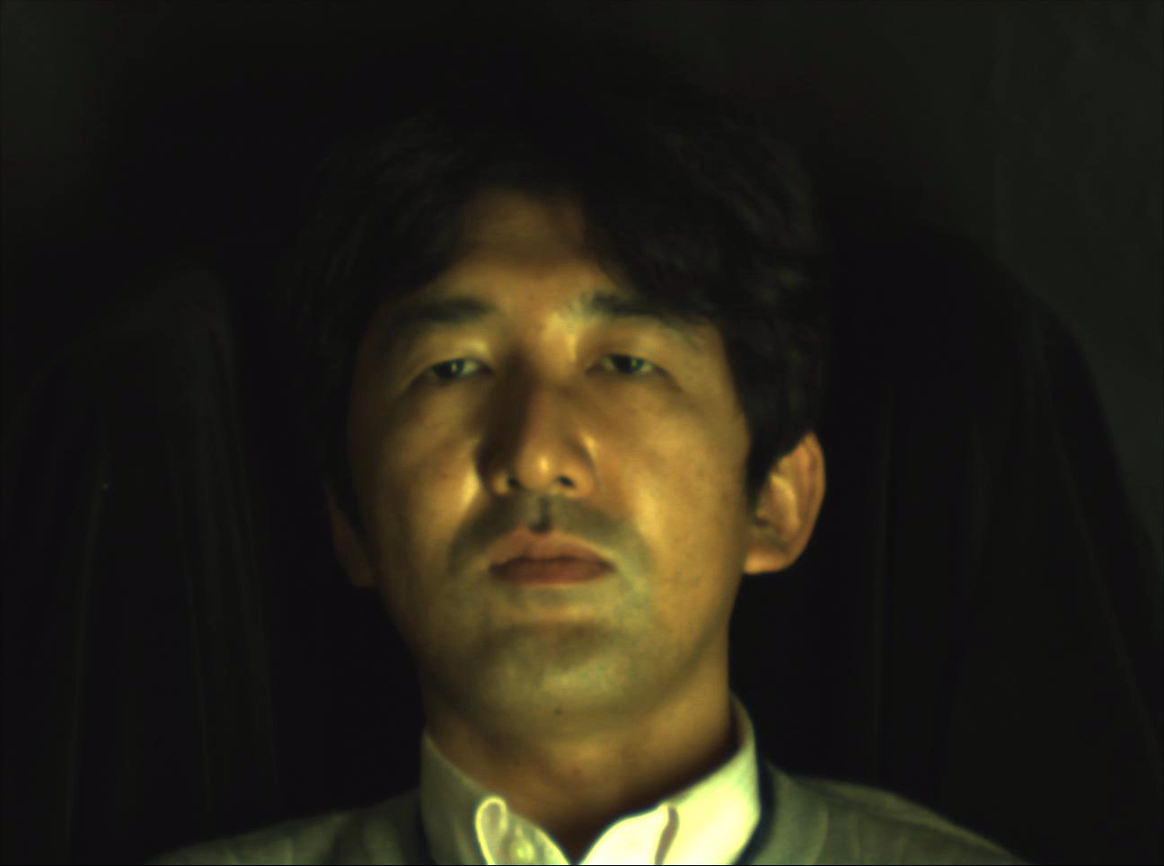
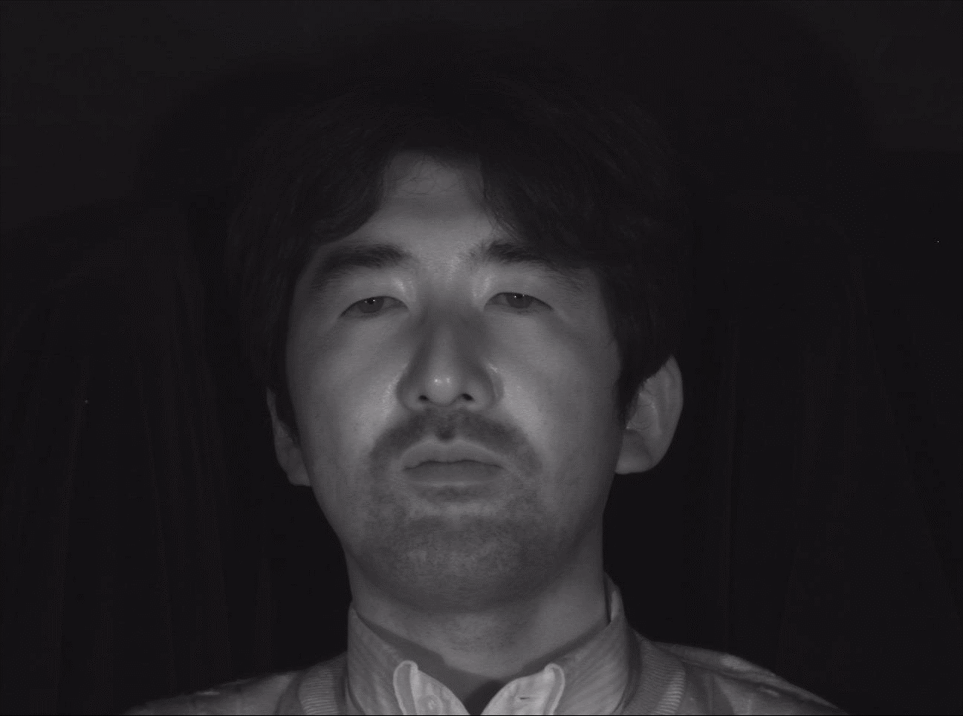
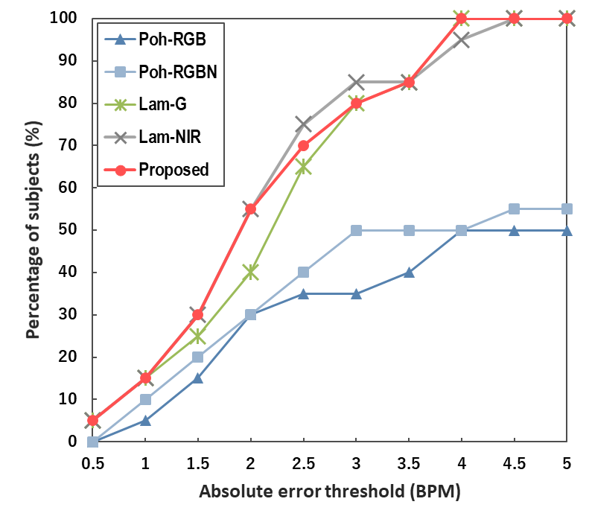
Experimental results
Lighting condition:
Sufficient lighting
Proposed
Lam-G
Lam-NIR
RGB video
NIR video
Percentage of subjects
that error < threshold (%)
Good
Good
Fluorescent light (600 lux)
NIR light
Absolute error threshold (BPM)

Slide 19
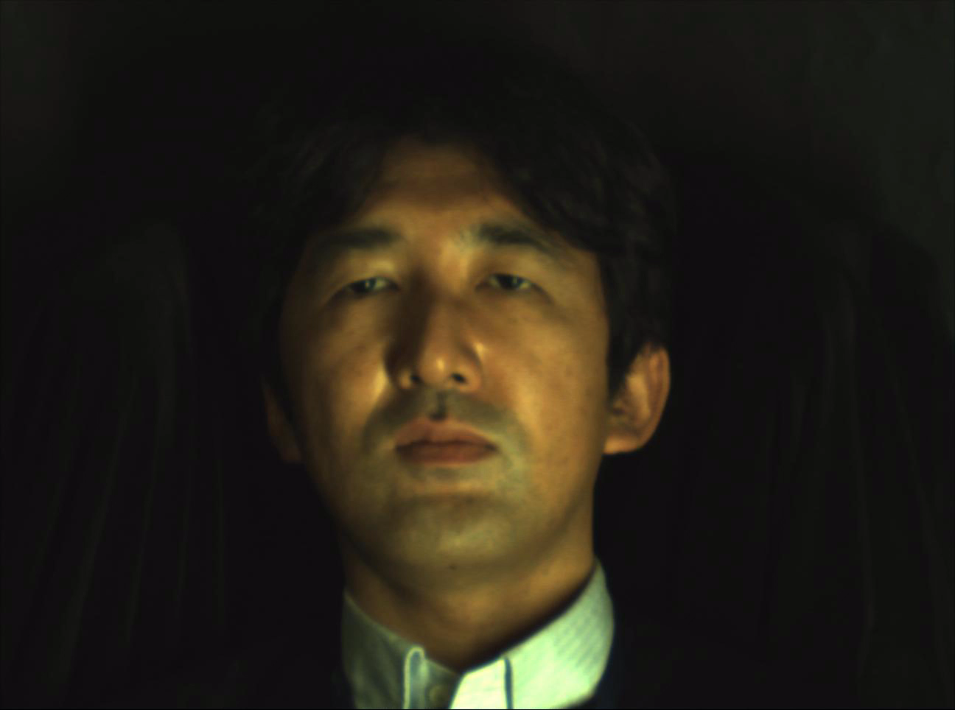
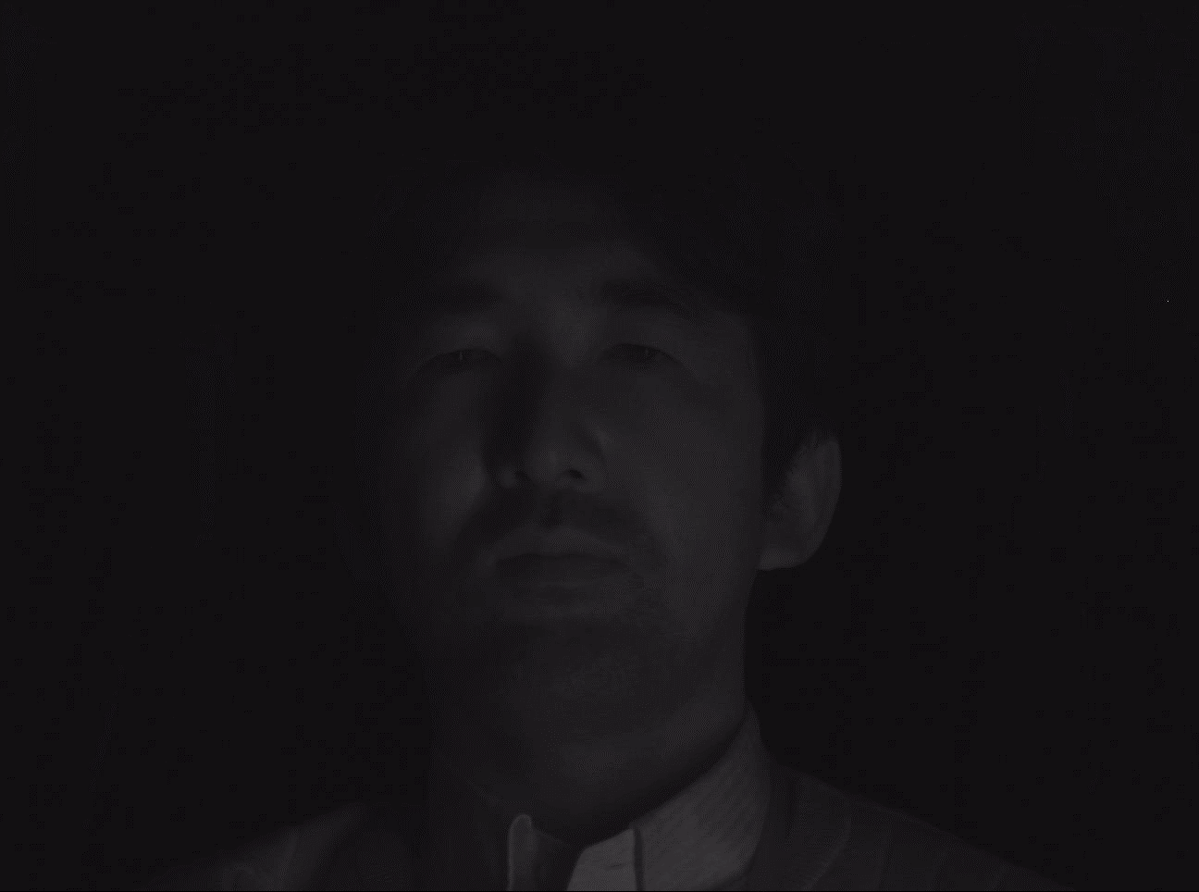
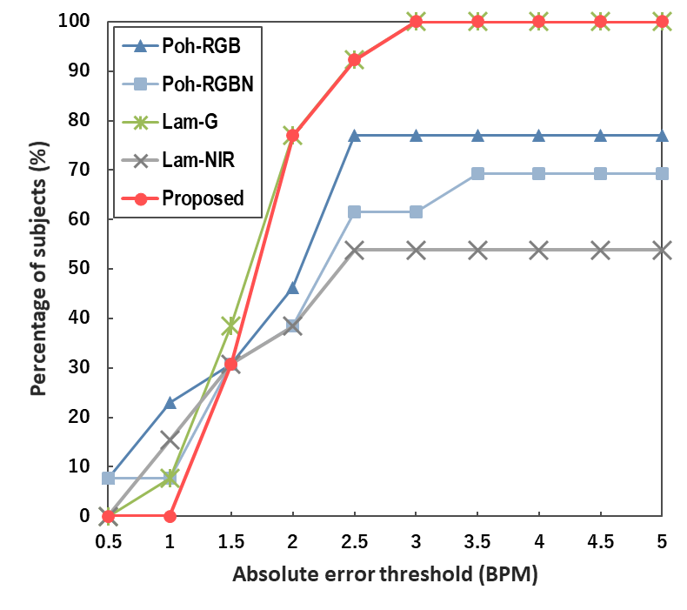
Experimental results
Lighting condition:
Only fluorescent light
Proposed
Lam-G
RGB video
NIR video
Percentage of subjects
that error < threshold (%)
Good
Bad
Fluorescent light (600 lux)
Absolute error threshold (BPM)

Slide 20
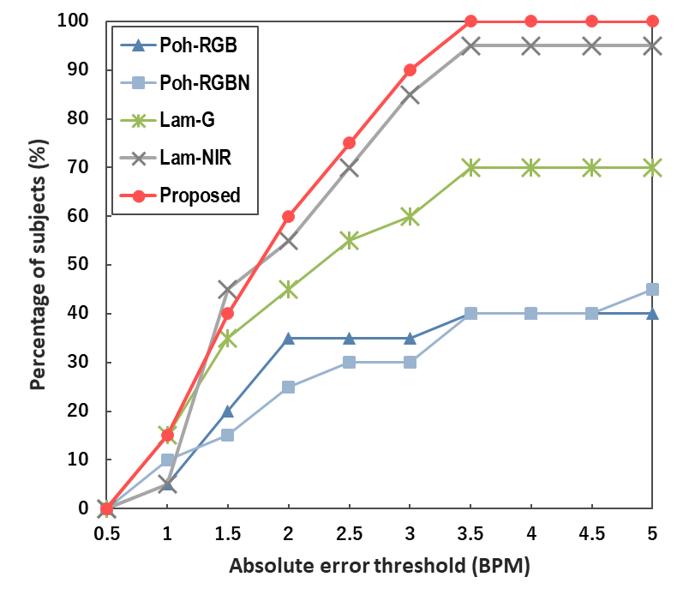
Experimental results
Lighting condition:
Low light condition
Proposed
Lam-NIR
RGB video
NIR video
Percentage of subjects
that error < threshold (%)
Bad
Good
Fluorescent light (50 lux)
NIR light
Absolute error threshold (BPM)

Slide 21
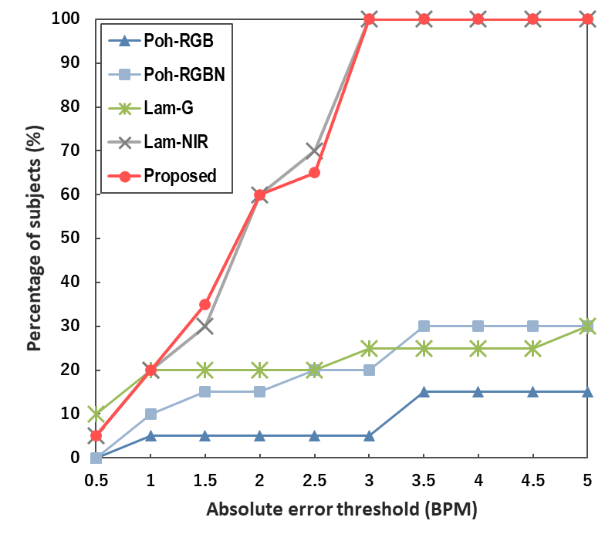

Experimental results
Lighting condition:
Illumination fluctuation
Proposed
Lam-NIR
RGB video
NIR video
Percentage of subjects
that error < threshold (%)
Bad
Good
Fluorescent light (50 lux)
NIR light
Movie was played on display
Absolute error threshold (BPM)
e.g. in theater

Slide 22
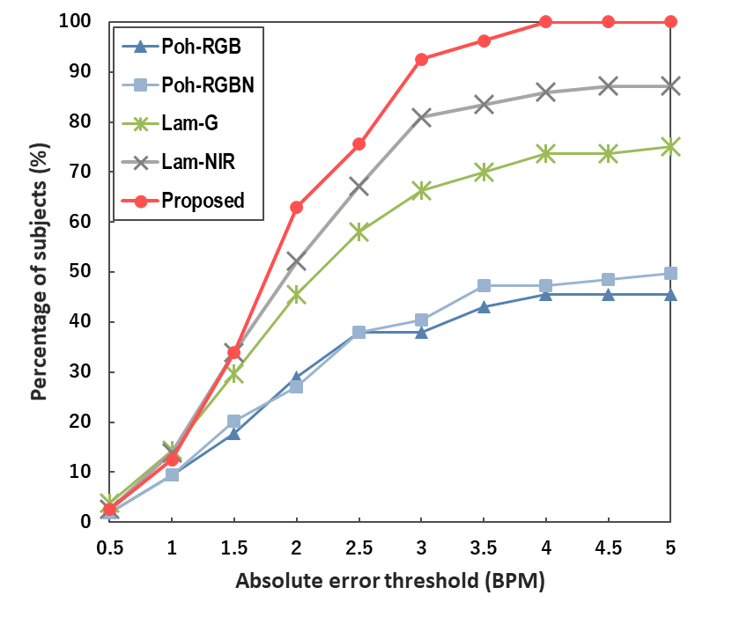
Experimental results
Proposed
Result of all 80 videos
(20 subjects × 4 scenes)
Percentage of subjects
that error < threshold (%)
Absolute error threshold (BPM)
Proposed method can estimate HR accurately
under various illumination conditions

Slide 23
Conclusion
Proposed a HR estimation method from
an RGB-NIR video based on spatial and spectral selection of suitable face patches
Demonstrated that our method can estimate HR robustly under various illumination conditions

