Slide 1
Inter-Beat Interval Estimation from Facial Video Based on Reliability of BVP Signals
Yuichiro Maki¹, Yusuke Monno¹, Kazunori Yoshizaki², Masayuki Tanaka^{1,3}, and Masatoshi Okutomi¹
¹Tokyo Institute of Technology ²Olympus Corporation
³National Institute of Advanced Industrial Science and Technology
International Conference of the IEEE Engineering in Medicine and Biology Society (EMBC2019)
July 27, 2019

Slide 2
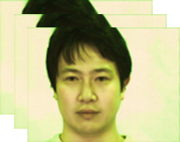
Background
Cardiac information
Heart rate (HR)
Inter-beat interval (IBI)
Facial video
Blood volume pulse (BVP)
Remote cardiac information measurement from facial video
Non-contact measurement
Low-cost and instant measurement
Multiple subjects measurement

Slide 3
What is blood volume pulse (BVP) ?
Camera
Estimation
Video-based BVP acquisition methods extract color change of skin surface.

Slide 4
HR and IBI
Average HR
Inter-Beat Interval
BVP
1.2 sec
0.8 sec
BVP
t
FFT
HR = 60$×$f’ BPM
t
f
f’
0[s]
1.2[s]
2.0[s]
Derived by
Dominant frequency
Derived by
Peak locations (More challenging)

Slide 5
HR and IBI
Average HR
Inter-Beat Interval
BVP
1.2 sec
0.8 sec
BVP
t
FFT
HR = 60$×$f’ BPM
t
f
f’
0[s]
1.2[s]
2.0[s]
IBI provides us with HRV parameters.
-> Important clues of many physiological and emotional states such as heart diseases and stress levels.

Slide 6
Contributions
We have proposed an IBI estimation method from facial video based on reliability of BVP signals.
We have validated our method with a newly constructed 300-fps dataset.
We have launched publicly available IBI estimation dataset and code.

Slide 7
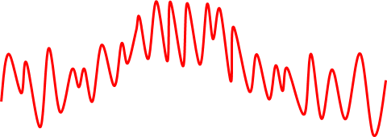
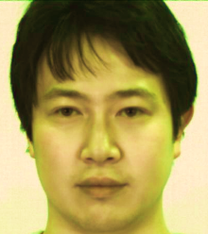
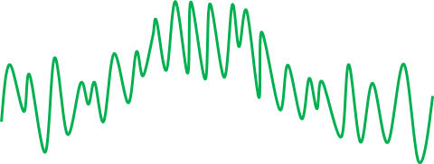
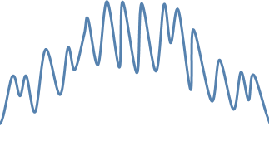
Poh et al. framework (IEEE TMBE, 2011)
Intensity signals
R
Time
Estimated BVP
G
ICA-based BVP estimation
FFT
Estimated HR
Input video
B
Time
Time
Time
ICA-based BVP estimation
Input: Multiple temporal intensity signals
Output: Estimated BVP

Slide 8
Poh et al. framework (IEEE TMBE, 2011)
Intensity signals
R
Time
Estimated BVP
G
ICA-based BVP estimation
Peak detection
Estimated IBI
Input video
B
Time
Time
Time
Estimated BVP is NOT stable for IBI estimation.

Slide 9
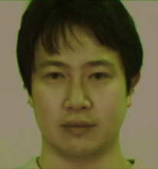
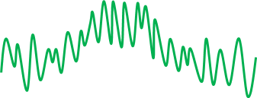
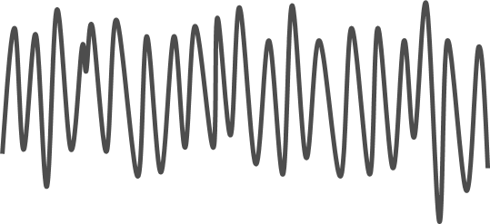
Lam et al. framework (ICCV, 2015)
Random patch sampling
G channel
Intensity signals
ICA-based BVP estimation
$$BVP_{1}$$
Estimated HR
FFT
HR
HR
ICA-based BVP estimation
$$BVP_{2}$$
Histogram
voting
FFT
HR
・・・
・・・
・・・
Estimated
HR

Slide 10
Our IBI estimation framework
Random patch sampling
G channel
Average intensity
ICA-based BVP estimation
$$BVP_{1}$$
ICA-based BVP estimation
$$BVP_{2}$$
Peak detection
Reliability based BVP selection
$$BVP_{best}$$
・・・
・・・
・・・
Estimated
IBI
$$BVP_{n}$$
We propose reliability-based BVP selection.
Only the most reliable BVP is used for IBI estimation.

Slide 11
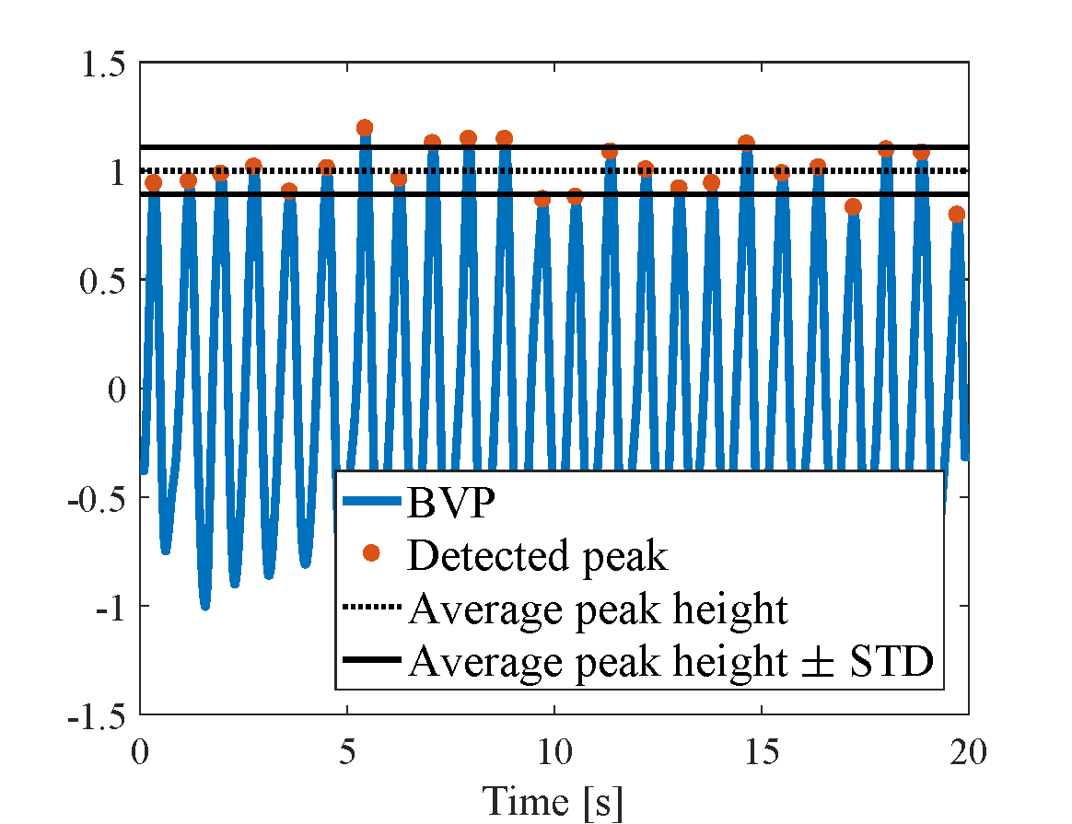
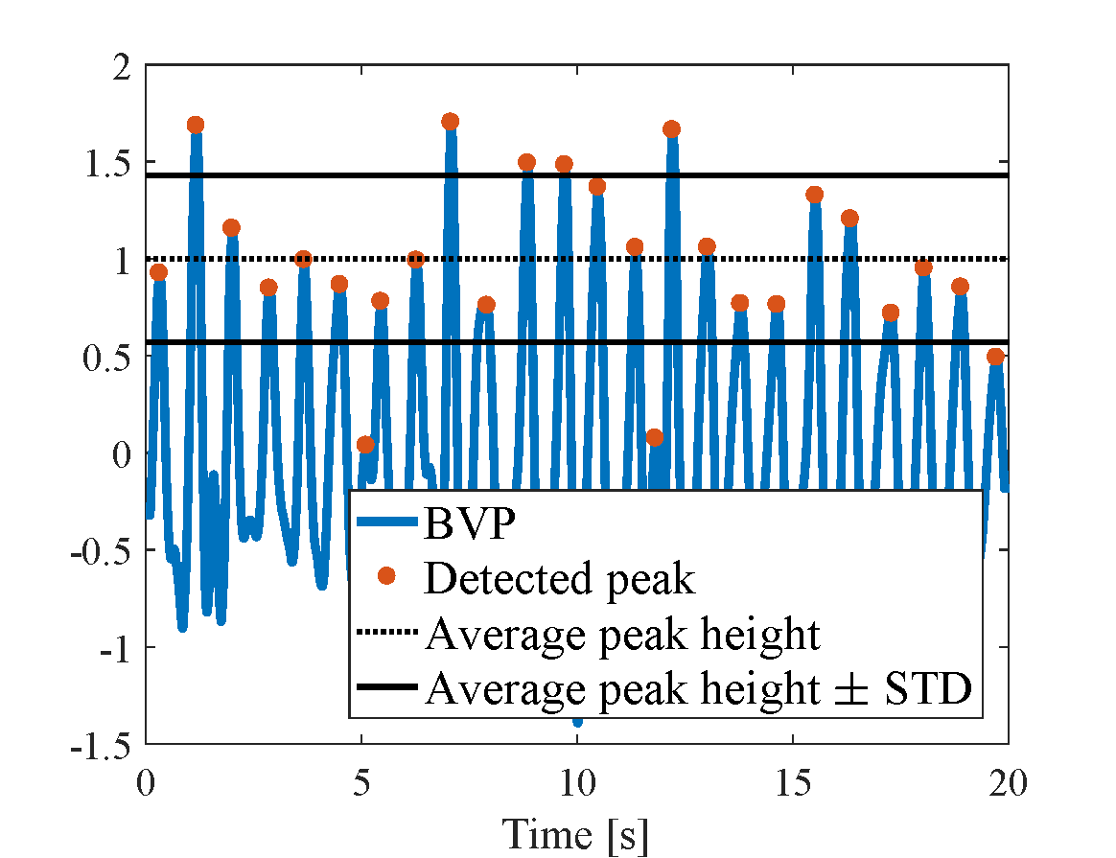
Reliability metric
Evaluate peak height variance of BVP
Low peak height variance: Reliable
High peak height variance: Unreliable
Low
variance
High
variance
Reliable BVP
Unreliable BVP

Slide 12
Peak detection
BVP candidates
BVP
Peak detection
IBI calculation
t
Outlier removal
All peaks within the gray band are ignored, assuming that maximum HR is 240 BPM.
Interpolation
Estimated IBI

Slide 13
IBI calculation
BVP candidates
BVP
Peak detection
IBI calculation
t
…
$$t_{1}$$
$$t_{2}$$
$$t_{3}$$
$$t_{4}$$
$$t_{5}$$
Outlier removal
$$t_{6}$$
$$t_{7}$$
$$t_{8}$$
IBI
$$t_{2}−t_{1}$$
$$t_{3}−t_{2}$$
Interpolation
Estimated IBI
t
…
$$t_{2}$$
$$t_{3}$$
$$t_{4}$$
$$t_{5}$$
$$t_{8}$$
$$t_{6}$$
$$t_{7}$$

Slide 14
Outlier removal
BVP candidates
BVP
Peak detection
IBI calculation
t
…
$$t_{1}$$
$$t_{2}$$
$$t_{3}$$
$$t_{4}$$
$$t_{5}$$
Outlier removal
$$t_{6}$$
$$t_{7}$$
$$t_{8}$$
IBI
$$IBI_{median}×1.2$$
Inlier
$$IBI_{median}$$
Interpolation
$$IBI_{median}×0.8$$
Outlier
Estimated IBI
t
…
$$t_{2}$$
$$t_{3}$$
$$t_{4}$$
$$t_{5}$$
$$t_{8}$$
$$t_{6}$$
$$t_{7}$$

Slide 15
Interpolation
BVP candidates
BVP
Peak detection
IBI calculation
t
…
$$t_{1}$$
$$t_{2}$$
$$t_{3}$$
$$t_{4}$$
$$t_{5}$$
Outlier removal
$$t_{6}$$
$$t_{7}$$
$$t_{8}$$
IBI
Interpolation
Estimated IBI
t
…
$$t_{2}$$
$$t_{3}$$
$$t_{4}$$
$$t_{5}$$
$$t_{8}$$
$$t_{6}$$
$$t_{7}$$

Slide 16
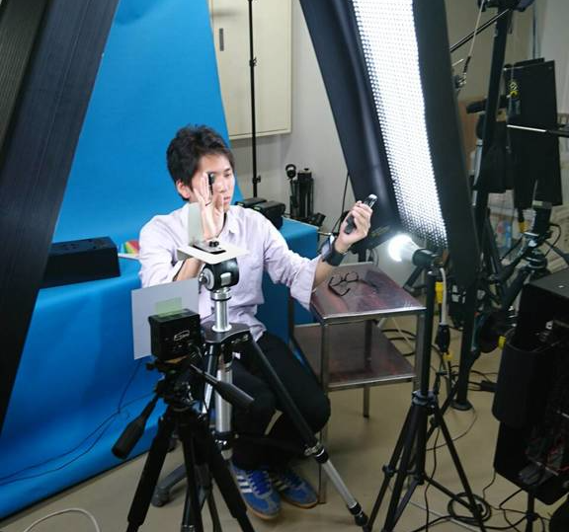
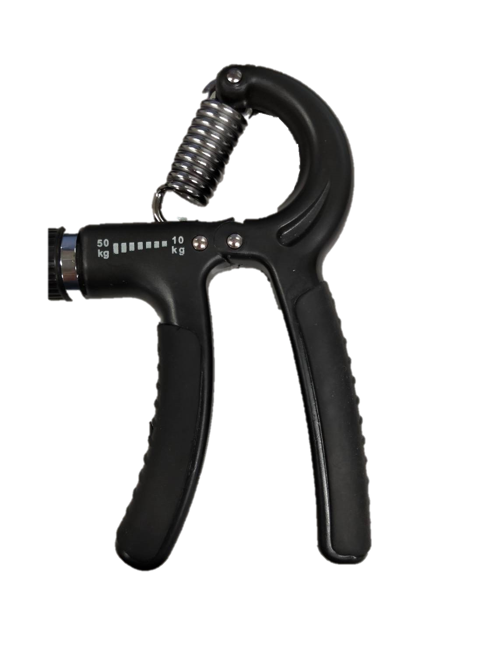
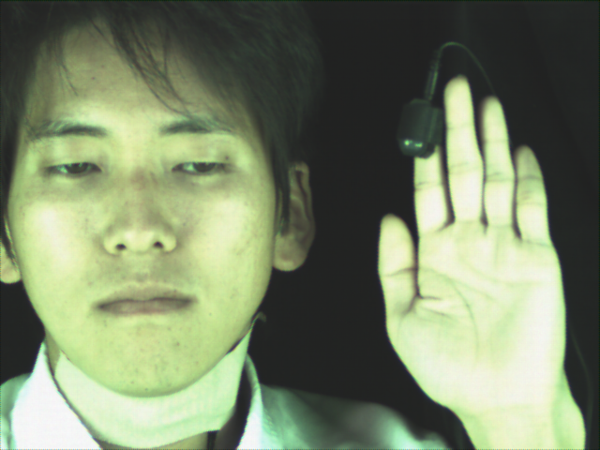
Experiment
Experimental setup
Exercise
To vary IBI
10-15 Kg, 60 times/min
Example of the frame
Fluorescent (FL) light
Contact PPG
Handgrip
Contact PPG
LED light
Exercise equipment (handgrip)
NIR light
Camera (300fps, VGA)

Slide 17
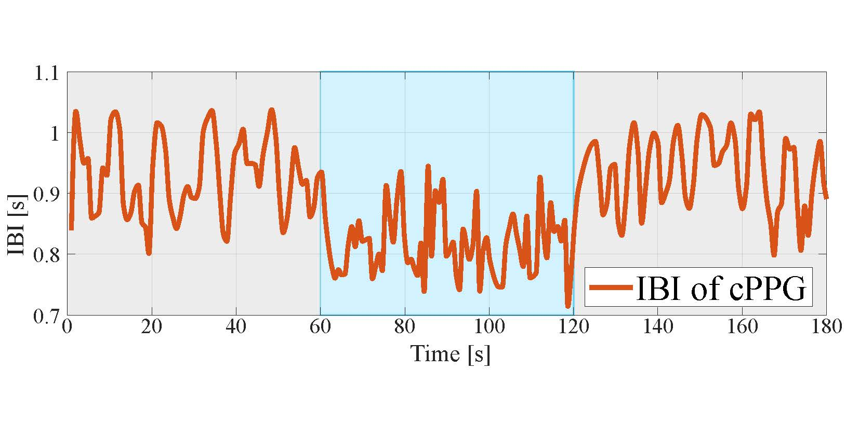
Experiment
Participants
9 subjects
Experimental flow
Relax
Exercise
Relax
60 [s]
60 [s]
60 [s]
IBI[s]
Time[s]

Slide 18
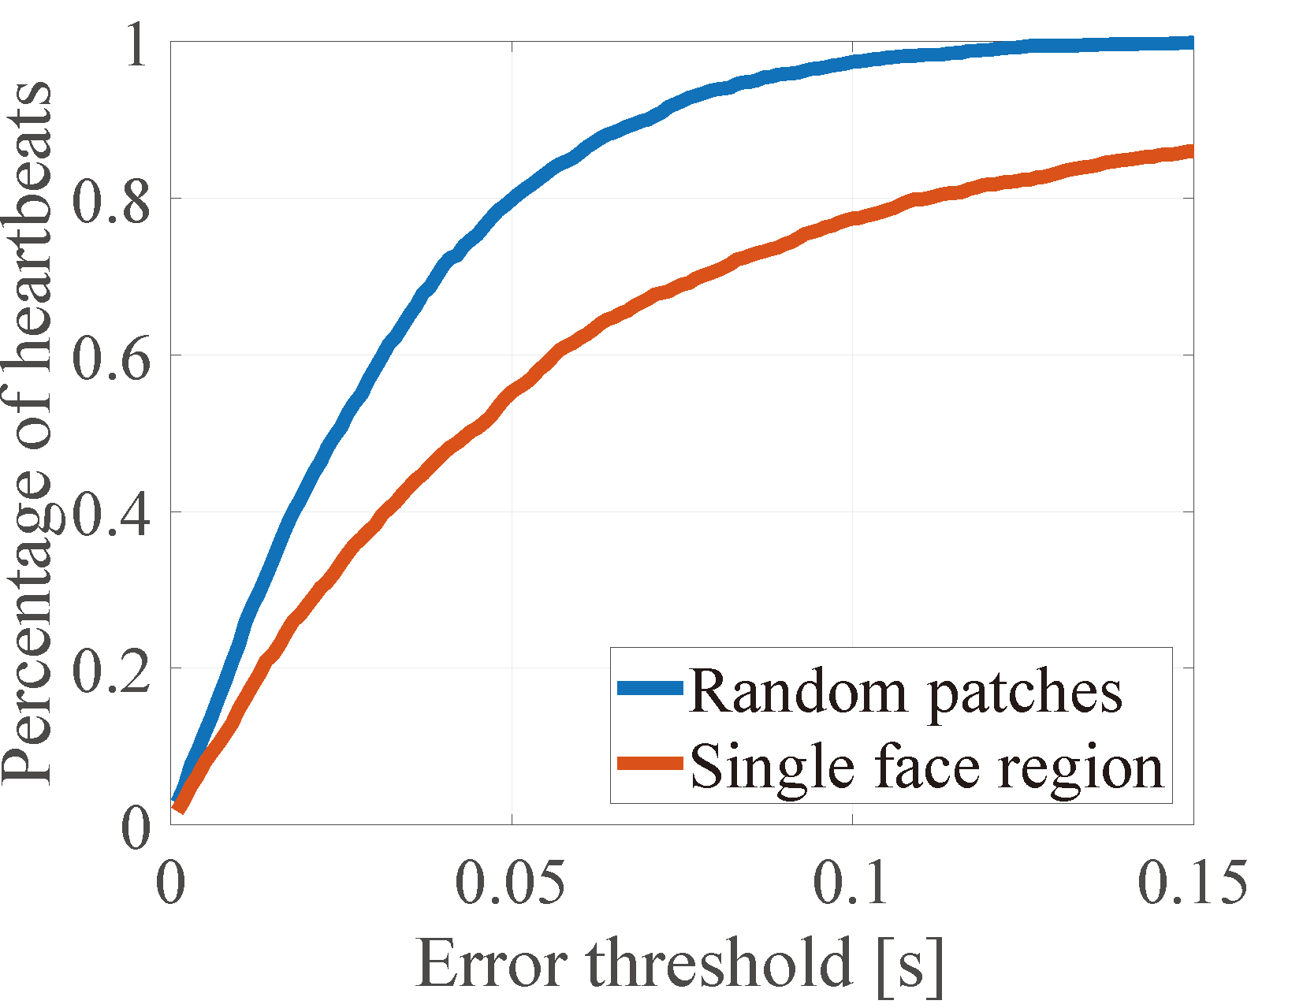
Result | Absolute error of IBI
$$Absolute Error of IBI=\left|IBI_{GrandTruth} −IBI_{Estimated}\right|$$
Improve!
Success rate
Sample: 9 subject $×$180 sec
Our proposed patch selection increases accuracy.

Slide 19
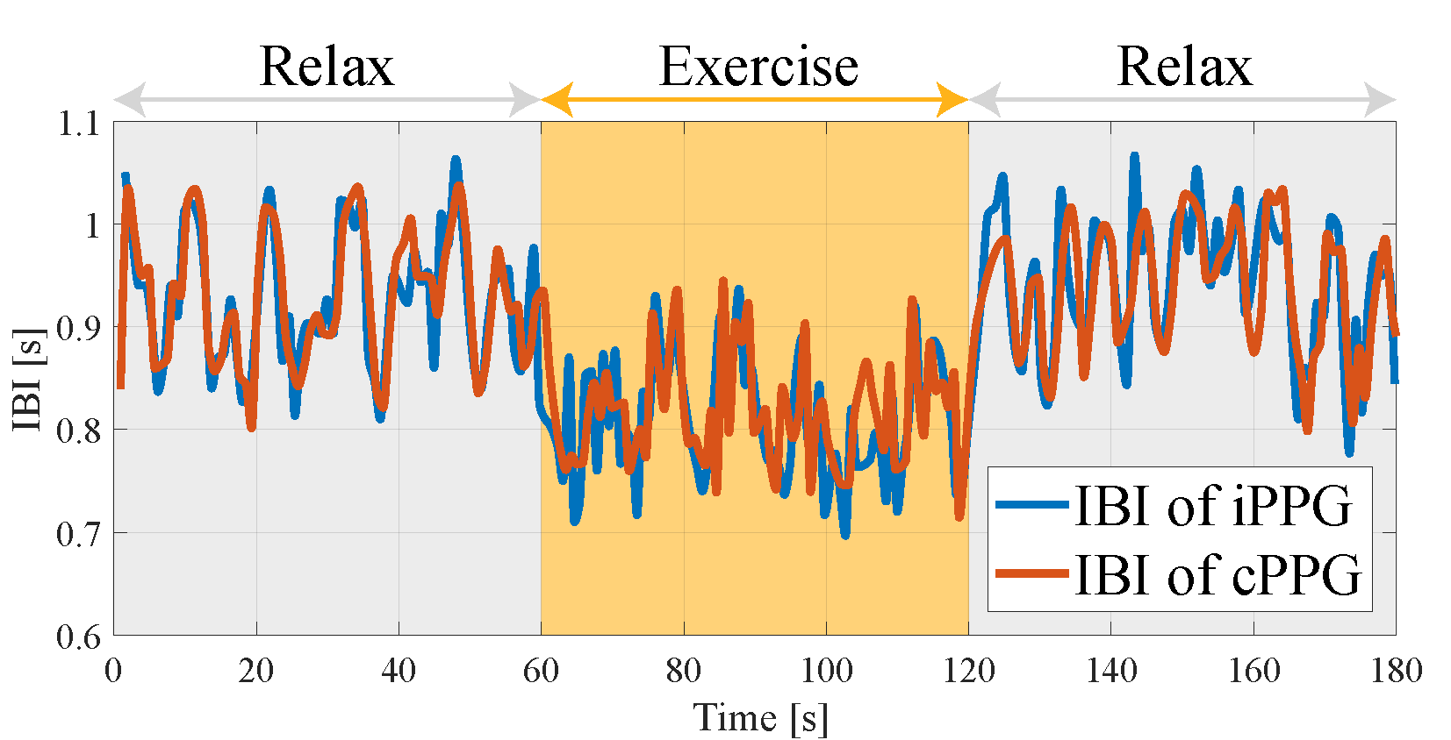
Result | Sequential IBI
Subject 1
IBI[s]
Estimated IBI
Ground-truth IBI
Time[s]
Estimated IBI and ground-truth IBI are well correlated in both relax and exercise sessions.

Slide 20
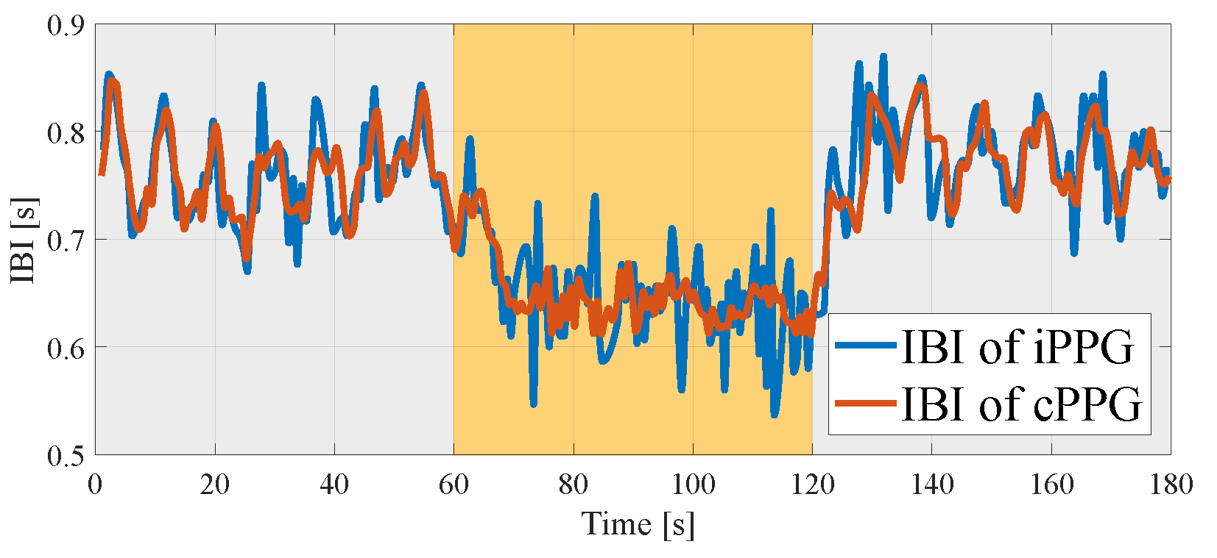
Result | Sequential IBI
Subject 1
IBI[s]
Estimated IBI
Ground-truth IBI
Time[s]
IBI[s]
Subject 2
Estimated IBI
Ground-truth IBI
Time[s]

Slide 21
Conclusion
We have proposed an IBI estimation method from facial video based on reliability of BVP signals.
We have validated our method with a newly constructed 300-fps dataset.
We have launched publicly available IBI estimation dataset and code.

Slide 22
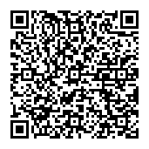
Dataset and code
Project page
Dataset
Videos of 9 subjects
Contact PPG data
* You have to agree End User License Agreement to download the dataset.
[Project page: http://www.ok.sc.e.titech.ac.jp/res/VitalSensing/remoteIBI/index.html ]
Code
Patch sampling-based candidate BVP acquisition
Reliability-based BVP selection
IBI calculation
Some other useful functions
[GitHub: www.github.com/ymonno/RemotePPG ]
Example of the dataset frame

